Slide 1
BAAR Debt Account Lifecycle
BAAR Phase 3 Training

Slide 2
Table of Contents
Segment 1: Debt Account Overview
Segment 2: Debt Account Creation
Segment 3: Internal Offsets
Segment 4: First Demand Letter and Subsequent Dunning Generation
Segment 5: Promissory Note Process
Segment 6: Collection from Debtor
Segment 7: Delinquency & Receivables Management
Segment 8: FedPay/TAP/AutoPay – Special Procedures
Segment 9: Debt Account Reports
Segment 10: Mass Import

Slide 3
Dunning
Segment 1:
Debt Account Overview

Slide 4
Table of Contents
Segment 1: Debt Account Overview
Debt Account Lifecycle Introduction
Claim Types
Segment 2: Debt Account Creation
Segment 3: Internal Offsets
Segment 4: First Demand Letter
Segment 5: Promissory Note Process
Segment 6: Collection from Debtor
Segment 7: Delinquency & Receivables Management
Segment 8: FedPay/TAP/AutoPay – Special Procedures
Segment 9: Debt Account Reports
Segment 10: Mass Import

Slide 5
Dunning
Debt Account
Lifecycle Introduction

Slide 6
Debt Account Lifecycle Introduction
Claims |  | Bills
What is a claim? | What is a bill?
Any debt/money owed to GSA arising from non-billing actions Claims are established for non-Federal debtors for the amount of money owed to GSA | Money owed to GSA as a result of GSA providing goods or services Bills are sent to Federal and non-Federal customers based on an agreed upon price
Example 1: GSA submits an overpayment to a separated employee and attempts to recoup the overpayment Example 2: GSA rents a vehicle to a Federal customer that is damaged in an accident | Example 1: GSA rents office space to a non-Federal customer and bills on a pre-defined amount Example 2: GSA rents a vehicle to a Federal customer and sends a bill for the vehicle rental amount
Notes:
A claim is any debt/money owed to GSA as a result of non-billing, non-goods or services providing actions by 1) GSA, 2) a GSA customer, 3) a GSA vendor, or 4) a separated (former) GSA employee.

Slide 7



Debt Account Lifecycle Introduction
\
Debt is owed to GSA
GSA Establishes a Debt Account
Financial transactions post against the Debt Account
In order to establish and manage a “claim” in Pegasys, we process the Debt Account Document
The Debt Account has two functions:
Establish and manage the claim in Pegasys through its lifecycle
Record the financial impact in the Pegasys General Ledger
Notes:
Debt Account Document Type:
Document Category = DA
Establishes the claim/debt in Pegasys
Accounts Receivable Transaction
I.e. money owed to GSA

Slide 8
Debt Account Lifecycle Introduction
Debt Account is Created
Send First Demand Letter
Collections are Processed
Establish Repayment Terms
Vehicle Claims Interface (Form Import)
Manual
Lockbox
Pay.gov via CIR
Manual
Dunning Notices are generated
Overdue Charges are Assessed
Repayment Status is Tracked
Produce Promissory Note
ARDUNNING
AROVERDUE
Disputes
Debts are Referred to Outside Entities
Process Write-Offs/Adjustments/Referrals
ARREFERSEL
ARTREOEX
AREOCOLL
ARWOSEL
ARWOGEN
Notes:
This diagram represents the complete Debt Account process flow.
We’ll look at different parts of the lifecycle throughout this section.

Slide 9
Dunning
Claim Types

Slide 10
Debt Account Claim Types
Claim Types: Region 6 and Region 7 claims are categorized into different “claim types” based on like characteristics
Pegasys Receivable Types: Used to record the Claim Type on Pegasys Debt Accounts
Provides the ability to perform the following within Pegasys:
Quickly identify the Debt Account as a pre-defined type of claim
Post the Debt Account to the appropriate General Ledger Accounts
Document how/when/if First Demand Letter is generated from Pegasys
Document the standard text on First Demand Letter and dunning notices
Document how/when overdue charges should be assessed
Document how/when subsequent dunning notices should be generated from Pegasys
Document how/when Debt Accounts become eligible for Treasury offset
Notes:
The full list of Region 6 and Region 7 Claim Receivable Types is included on this slide and the next. The Receivable Type is used to record the type of claim. Debt Account documents and Cash Receipts referencing the Debt Account will utilize the Receivable Type to determine Transaction Definition flexible postings.

Slide 11
Debt Account Claim Types
Region 6 Claim Receivable Types:
Claim Group | Receivable Type | Name | Pegasys Entry Method
R6CLAIMS | VNCLAIMR6 | Vendor Claims | Automated (interface)
 | WSCLAIMR6 | Waste Paper/Scrap Claims | Manual
R6PRCLAIMS | PRCLAIMR6 | Payroll Claims
R6POCLAIMS | VEHCLAIM | Vehicle
 | APCLAIMR6 | Autopay Claims
 | FPCLAIMR6 | Fedpay Claims
 | TACLAIMR6 | TAPS Claims
 | ADCLAIMR6 | Aggregate Discount Claims
 | AUCLAIMR6 | Audit Related Claims
 | ECCLAIMR6 | Excess Cost Claims
 | FICLAIMR6 | FOIA Claims
 | IFCLAIMR6 | IFF Claims
 | LDCLAIMR6 | Liquidated Damages Claims
 | RPCLAIMR6 | Restitution Payments Claims Collections
 | NCCLAIMR6 | Compliance Payments Claims Collections
Notes:
The full list of Region 6 and Region 7 Claim Receivable Types is included on this slide and the next. The Receivable Type is used to record the type of claim. Debt Account documents and Cash Receipts referencing the Debt Account will utilize the Receivable Type to determine Transaction Definition flexible postings.

Slide 12
Debt Account Claim Types
Region 7 Claim Receivable Types:
Claim Group | Receivable Type | Name | Pegasys Entry Method
R7CLAIMS | PRCLAIMR7 | Property Damages Claims | Manual
 | FRCLAIMR7 | Fraud Claims
 | LDCLAIMR7 | Liquidated Damages Claims
 | CDCLAIMR7 | Contract Dispute Claims
 | DPCLAIMR7 | Duplicate Payment Claims
 | ETCLAIMR7 | Early Termination Claims
 | EPCLAIMR7 | Erroneous Payment Claims
 | LTCLAIMR7 | Litigation Claims
 | RSCLAIMR7 | Restitution Claims
 | STCLAIMR7 | Settlement Claims
 | UCCLAIMR7 | Utility Credit Claims
Notes:
The full list of Region 6 and Region 7 Claim Receivable Types is included on this slide and the next. The Receivable Type is used to record the type of claim. Debt Account documents and Cash Receipts referencing the Debt Account will utilize the Receivable Type to determine Transaction Definition flexible postings.

Slide 13
Dunning
Segment 2:
Debt Account Creation

Slide 14
Table of Contents
Segment 1: Debt Account Overview
Segment 2: Debt Account Creation
Debt Account Characteristics
Debt Account Document Overview
Claim Initiation Process
Debt Account Entity and Queries
Segment 3: Internal Offsets
Segment 4: First Demand Letter
Segment 5: Promissory Note Process
Segment 6: Collection from Debtor
Segment 7: Delinquency & Receivables Management
Segment 8: FedPay/TAP/AutoPay – Special Procedures
Segment 9: Debt Account Reports
Segment 10: Mass Import

Slide 15
Dunning
Debt Account
Characteristics

Slide 16
Debt Account Characteristics
Key Characteristics of Debt Accounts
Provide the ability to record the Debtor on the claim
The Debtor is stored in Pegasys as the Vendor Code/Vendor Address Code associated to the Debt Account
Optionally: May contain a payment schedule based on a Promissory Note
If a signed/notarized Promissory Note has been received, the payment schedule will be defined by the Amortization Schedule associated to the Debt Account
Expenditure vs. Revenue Claims
Expenditure Claims are identified by recording the Sub-Object Class (SOC) accounting dimension, e.g. Vendor, Payroll, Early Termination
Revenue Claims are identified by recording the Revenue Source Code (RSC) accounting dimension, e.g. Vehicle, Property Damages, IFF Claims
Notes:
Speaker Notes: Before taking a look at the Debt Account document in detail, we will want to cover some key characteristics specific to GSA’s Debt Accounts.

Slide 17
Debt Account Characteristics
Key Characteristics of Debt Accounts (cont.)
First Demand Letter Generation:
The First Demand Letter can be generated either externally or directly from Pegasys
Non-Program Office Claims: First Demand Letter generated/sent from Pegasys
Program Office Claims: First Demand Letter generated/sent externally (directly from the affiliated GSA Program Office)
Subsequent Dunning Notice Generation:
Pegasys will also generate any subsequent Dunning Notices 30 days after the First Demand Letter is sent to the Debtor
Lag Days between subsequent Dunning Notices = 30 days
Notes:
Speaker Notes: Before taking a look at the Debt Account document in detail, we will want to cover some key characteristics specific to GSA’s Debt Accounts.

Slide 18
Dunning
Debt Account
Document Overview

Slide 19
Debt Account Document Overview
\
The Debt Account (DA) document is similar to the Billing Document (BD):
Collections can be applied against the DA
Overdue Charges can be assessed when a debtor does not pay on time
Referrals can be sent to Treasury when collection attempts fail
Write-Offs can be processed when it is anticipated a collection will not be received
The Debt Account (DA) is different from the Billing Document (BD):
Debt Accounts provide the ability to record flexible payment terms (Amortization Schedule and Promissory Note)
Monthly payments of 1) principal and 2) interest
Debt Accounts are NOT transmitted to VCSS
Debt Accounts utilize a unique set of Pegasys queries

Slide 20
Debt Account Document Overview
Debt Account Document Type:
Document Category = DA
Region | Doc Type | Processing | Document Type Name
Region 6 | DAV | Automated | R6 Vehicle Claims
Region 6 | D6M | Manual | R6 Claims – Manual
Region 6 | DES | Manual | External Services Claims – Manual
Region 7 | D7M | Manual | R7 Claims – Manual

Slide 21
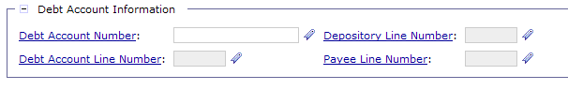
Debt Account Document Overview – DA Entity
Debt Account Entity
Established upon processing of the Debt Account document
Once a Debt Account Entity is established in Pegasys, downstream processing activity referencing the Debt Account can begin
Debt Account Entity and all updates are viewable via the Debt Account Query
All activity for a given Debt Account references the Debt Account Entity, NOT the Debt Account document
Debt Account Entity referencing transactions will include:
Cash Receipts – collections, write-offs
Itemized Payments – debtor refunds

Slide 22
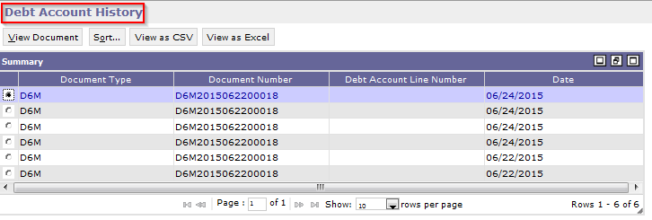
Debt Account Document Overview – DA Entity
Debt Account Entity
Once the Debt Account Entity is established, the entity can be UPDATED.
To update the Debt Account Entity, users must use the Pegasys Amendment functionality.
Users will not correct the Debt Account document
Users will not process new Debt Account documents to update the entity
Each Amendment is tracked/audited using a unique system-generated Amendment Number
The Debt Account Entity’s Amendment History can be reviewed on the Debt Account Query’s History page.
The History page can be accessed by clicking the History button on the Debt Account Query

Slide 23
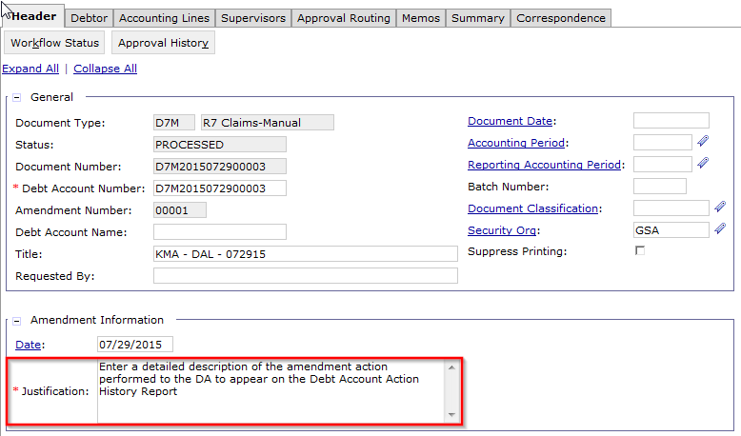
Debt Account Document Overview – DA Entity
Debt Account Action History - Amendments
When processing Amendments to Debt Accounts, it is critical to enter a detailed Amendment Justification for audit purposes
The Amendment Justification will be pulled on the Debt Accounts Action History Report and will identify on the report the update made to the DA.

Slide 24
Debt Account Document Overview – DA Entity
Debt Account Document – Entity Relationship
1
2
3
Initial Debt Account Creation
(06/11/2015)
Line Amount Increase of $100
(06/17/2015)
Correction of the Revenue Source Code – (RSC)
(07/02/2015)
Debt Account Entity (Debt Account #: 6111579)
New DA Document
DAV201506110001
Debt Account #: 6111579
DA Amendment #1
DAV201506110001
Debt Account #: 6111579
DA Amendment #2
DAV201506110001
Debt Account #: 6111579

Slide 25
Debt Account Document Overview - Tabs
The following tabs on the Debt Account will be used by GSA:
Header – Records Debt Account Number, Document Number, Document Date, Principal and IP&A Amounts, User Defined Fields, etc.
Debtor – Records Vendor (debtor) information, including Vendor Code, Address Code, Name, Debt Account Group ID
Debt Account Group ID: Identifies Region 6 vs. Region 7 Debt Accounts
Accounting Line – Records Debt Account Line Number, Transaction Type, Status, Start/End Dates, Receivable Type, Accounting Dimensions, etc.
Charge Lines: Sub-tab of the Accounting Lines tab, recording:
Amortization Schedule (Promissory Note) Interest
Overdue Interest, Penalty, and Administrative Charges
Correspondence – Provides the ability to record communications with the debtor directly on the Debt Account in Pegasys

Slide 26
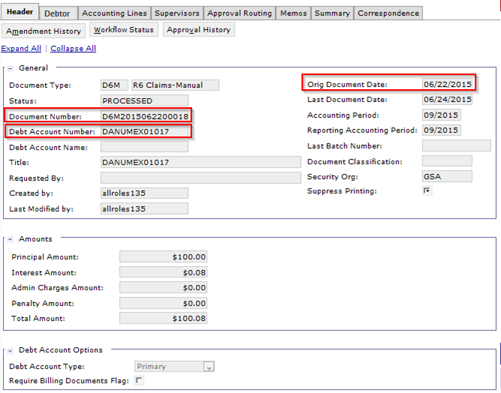
Debt Account Document Overview - Header
Field Name | Description
Document Number | The unique number that identifies the document.
Debt Account Number | The alphanumeric code defining the Debt Account. The Claim Number is recorded in this field.
Document Date | The date the Debt Account was created. If no value is entered, the system defaults this value to the current date.

Slide 27
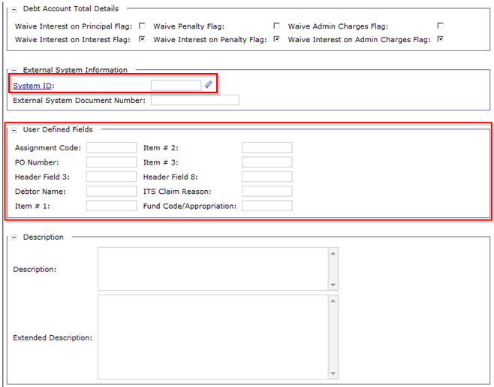
Debt Account Document Overview - Header
D6M Specific Document Header Fields (Cont.)
Field Name | Description
External System ID | Identifies the external system. Valid values: R6CLAIMMNL, CARS, PRG, GSA
User Defined Fields | See next slide for listing of Header level UDFs per each DA document type.

Slide 28
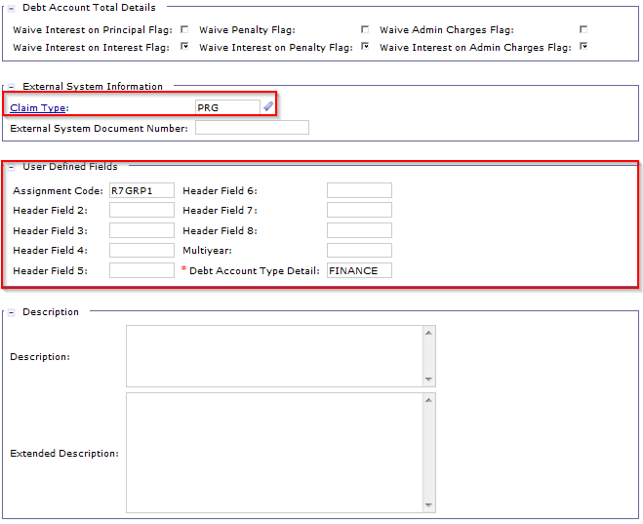
Debt Account Document Overview - Header
D7M Specific Document Header Fields
Field Name | Description
Claim Type | Identifies the Claim Type. Valid values: PRG, Finance
User Defined Fields | See next slide for listing of Header level UDFs per each DA document type.

Slide 29
Debt Account Document Overview - UDFs
The Debt Account Document Type is configured to use specific User Defined Fields (UDFs) at both the Header and Accounting Line Level
Users may enter 10-digit alphanumeric values in the UDFs
Header UDFs configured for use on Debt Account Document Types:
Header UDF # | DAV | D6M | DES | D7M
1 | Assignment Code | Assignment Code | Assignment Code | Assignment Code
2 | N/A | PO Number | PO Number | N/A
3 | Vehicle Tag Number | N/A | N/A | N/A
4 | Debtor Name | Debtor Name | Debtor Name | N/A
5 | N/A | Item #1 | Item #1 | N/A
6 | N/A | Item #2 | Item #2 | N/A
7 | N/A | Item #3 | Item #3 | N/A
8 | Insurance Claim Number | N/A | N/A | N/A
9 | N/A | ITS Claim Reason | ITS Claim Reason | N/A
10 | Referral Options | Referral Options | Referral Options | Debt Account Type Detail

Slide 30
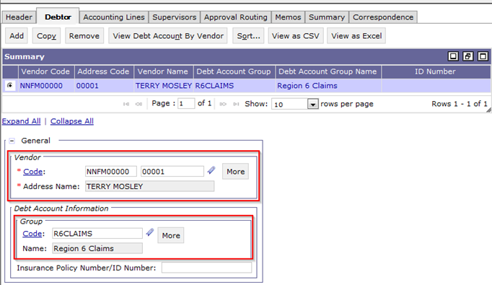
Debt Account Document Overview - Debtor
Field Name | Description
Vendor Code/Address Code | Identifies the debtor. The combination of Vendor Code and Vendor Address Code must be valid on the Vendor Type maintenance table.
Debt Account Group | The group code the Debt Account and Vendor is associated with in Pegasys. Must be a valid value on the Debt Account Group table. Valid values: R6CLAIMS, R7CLAIMS, ESCLAIMS

Slide 31
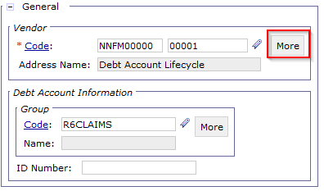
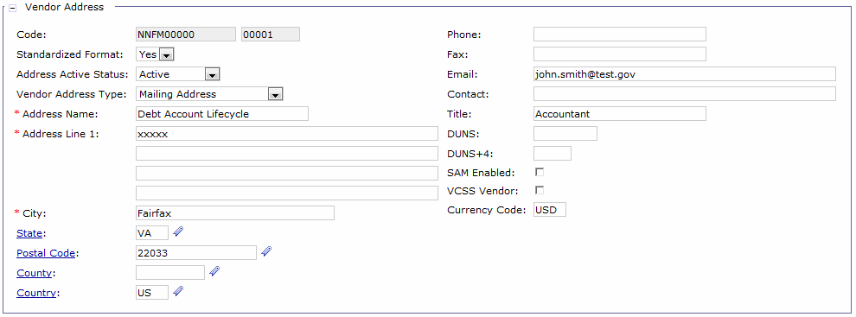
Debt Account Document Overview - Debtor
At times, a “dummy” miscellaneous vendor code is used instead of a vendor code associated with the Debtor (e.g., Vehicle Claims)
In this case, the miscellaneous vendor code/address code is entered in the Vendor Code/Address Code fields and the user manually enters the Debtor Information under the More button

Slide 32
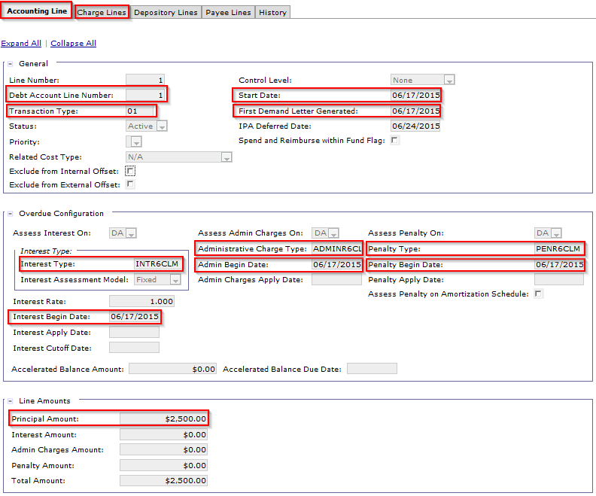
Debt Account Document Overview – Accounting Line

Slide 33
Debt Account Document Overview – Accounting Line
Field Name | Description
Debt Account Line Number | The numeric value of the Debt Account Line (will be recorded on referencing collection and refund transactions)
Transaction Type | An alphanumeric code used in combination with the transaction’s Document Type to infer General Ledger (GL) postings. Must be valid in the Transaction Definition maintenance table.
Principal Amount | Displays the principal dollar amount initially owed before overdue charges are applied.
Start Date | The start date of the Debt Account
Interest, Penalty, & Admin Charge Types | The type of Interest, Penalty, or Admin charge to be applied to overdue DAs. Must be a valid code on the IP&A Type reference tables, e.g. INTR6CLM.
Charge Lines Sub-Tab | Records overdue IP&A charge lines associated to the accounting line.
First Demand Letter Generated Date | The date on which the first demand letter is sent to the debtor.
IP&A Start Dates | The date on which IP&A will begin to be applied to the DA.

Slide 34
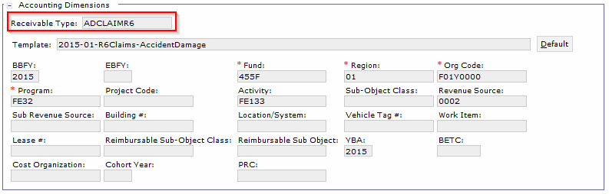
Debt Account Document Overview – Accounting Line
Field Name | Description
Receivable Type | The Receivable Type denoting the type of claim, e.g. PRCLAIMR7, VNCLAIMR6, FPCLAIMR6, etc.
Accounting Dimensions | Includes the BBFY, Fund, Region, Org Code, Program, Activity, SOC, RSC, etc.

Slide 35
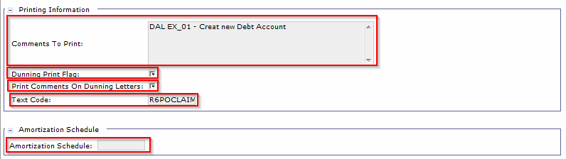
Debt Account Document Overview – Accounting Line
Field Name | Description
Comments to Print | Any comments to be printed on the demand letter beyond the standard text. - Region 7: Should be used to record any comments to be printed on the demand letter beyond the standard text - Region 6: In addition to any comments beyond standard text, can also record "Payroll Claim Reason" or "Initial Demand Letter Reason".
Dunning Print Flag | If True, Dunning Notices will be generated for the Debt Account.
Print Comments on Dunning Letters | Must be set True if text entered in the Comments to Print field should be printed on the First Demand Letter (if generated out of Pegasys) and any subsequent Dunning Notices.
Text Code | Used to determine the pre-defined text to print on the demand letter.
Amortization Schedule | The Amortization Schedule associated with the Debt Account, if any.

Slide 36
Debt Account Document Overview - UDFs
The Debt Account Document Type will be configured to use specific User Defined Fields (UDFs) at both the Header and Accounting Line Level
Users may enter 10-digit alphanumeric values in the UDFs
Accounting Line UDFs configured for use on Debt Account Document Types:
\
Actg. Line UDF # | DAV | D6M | DES | D7M
1 | N/A | Sales Office Number | Sales Office Number | Fedcode/Customer Fund Code
2 | N/A | Sale Number | Sale Number | Lease Number
3 | N/A | Labor Flag | Labor Flag | Product Code
4 | N/A | Sep Date | Sep Date | Order Number
5 | N/A | GSA Contract Number | GSA Contract Number | Customer Code
6 | N/A | Commodity Code | Commodity Code | Pay.gov Tracking ID
7 | N/A | ACO Zone | ACO Zone | FAS PO Number
8 | N/A | ACO Code | ACO Code | TD Code/Transaction Code
9 | Lease Vehicle Flag | N/A | N/A | Additional Codes
10 | N/A | N/A | N/A | N/A

Slide 37
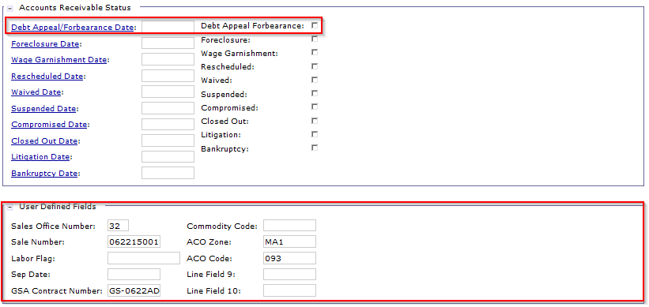
Debt Account Document Overview – Accounting Line
Field Name | Description
Debt Appeal Forbearance Flag/Date | Indicates whether the Debt Account is under dispute. This flag, as well as the Debt Appeal Forbearance Date will be populated when a dispute is recorded in association with the Debt Account.
User Defined Fields | See previous slides for listing of Accounting Line level UDFs per each DA document type.

Slide 38
Debt Account Document Overview Adding an Attachment
Users can add attachments to DAs for internal use (Pegasys)
The attachment is added directly to the DA document
Files containing PII data should not be added as an attachment
Steps to add an attachment:
Click the Attachments Button on the Pegasys document
Click the Import Local File button
Enter required and relevant fields
Select the Browse button and choose the file to attach
Select the Upload button
Select the Return button to Navigate back to the Cash Receipt Document
Notes:
Speaker Note: Please do not include images of a check as this is PII sensitive information.

Slide 39
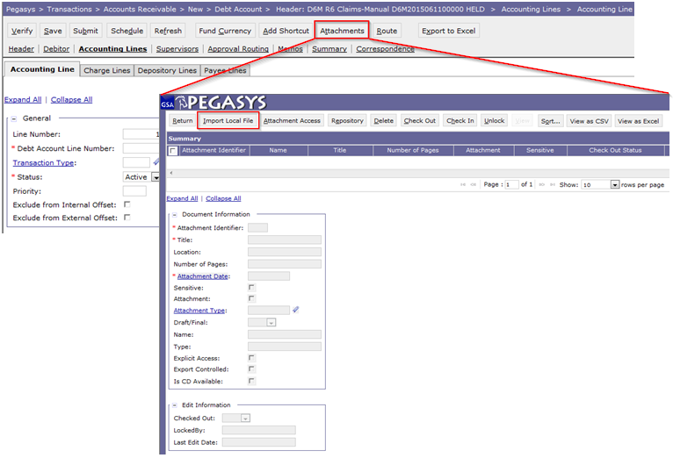
Debt Account Document Overview Adding an Attachment
Click the Attachments Button on the Pegasys document
Click the Import Local File button
Notes:
Speaker Note: Click attachments button. This is what screen looks like when you do.
Speak Note: Attachment Date is date attachment is added to the Form or Document.

Slide 40
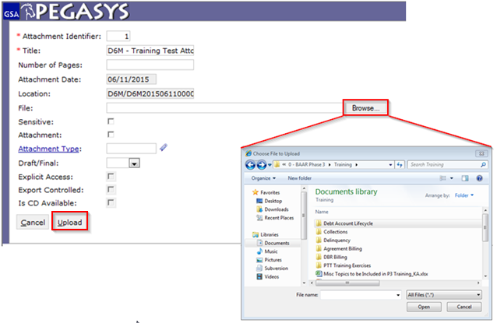
Debt Account Document Overview Adding an Attachment
Enter required and relevant fields
Select the Browse button and choose the file to attach
Select the Upload button
Notes:
Fill in required fields (marked with astrix), click Browse. Pop up window comes up. choose file, click open. When finished, click Upload

Slide 41
Debt Account Document Overview Correspondence
Debt Account Correspondence supports:
Internal communication and tracking using Pegasys
Ability to add attachments to the correspondence record
Can be created for, associated with, and viewable from Debt Account documents
Debt Account Correspondence provides the ability to:
Document any direct communication with the Debtor
Single Debt Account Source of Correspondence:
Pegasys: GSA/USDA user-entered correspondence

Slide 42
Debt Account Document Overview Correspondence
Steps to create Document Level Correspondence on a Debt Account:
Open the Debt Account document in View mode
Navigate to the Correspondence tab
Click Add
Select the newly added Correspondence record
Enter applicable fields:
Click Save
First Name (Contact Person) | Public Publishing
Last Name (Contact Person) | Correspondence
Communication Source | Accounting Line Number
Type of Correspondence
* | Newly created documents must first be Saved before a user can enter Correspondence
Notes:
Speaker Note: You can add correspondence in view, correct or amend. You can also add correspondence when a document is originally created as long as the form is SAVED first!!
Field values generated upon saving:
Creator: The user ID of the person that created the record.
Created Date: The date correspondence was first entered.
Record Number: The sequential number given to the correspondence record upon saving.
Last Modified By: ID of person who last made an update to the record.
Last Modified Date: Date record was last modified
Additional Info on fields:
Assignment Code: The code used to identify the GSA user responsible managing the Debt Account.
Type of Correspondence: A drop down box containing correspondence types (Null, Resolution, Communication, Question, Chargeback, Chargeback - Resolution, Dispute and Other).
Communication Source: Dropdown: (External System, Phone, Fax, Mail/Email, VSS)
Public Publishing: Specifies if the correspondence record should be transmitted to VSS for public viewing. Defaults to False.
Correspondence: Free form space provided for the user to enter the text to convey to the intended recipient.

Slide 43
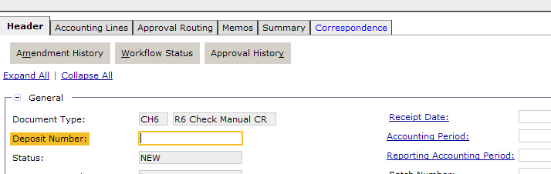
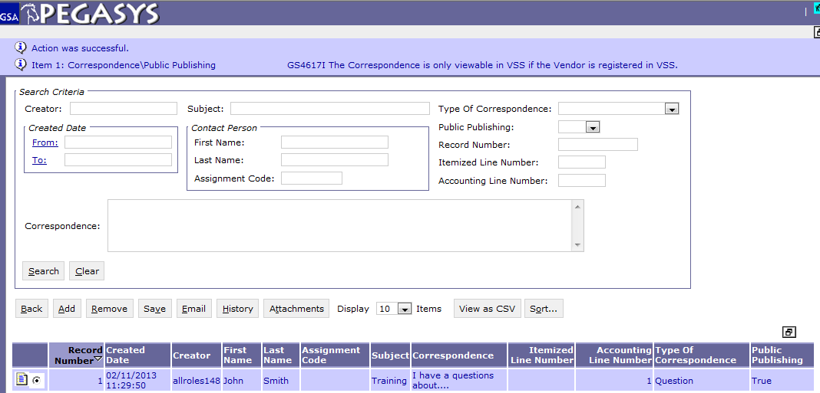
Debt Account Document Overview Correspondence
Notes:
Click correspondence tab. This is what screen looks like. Show Back, Add, Save buttons.

Slide 44
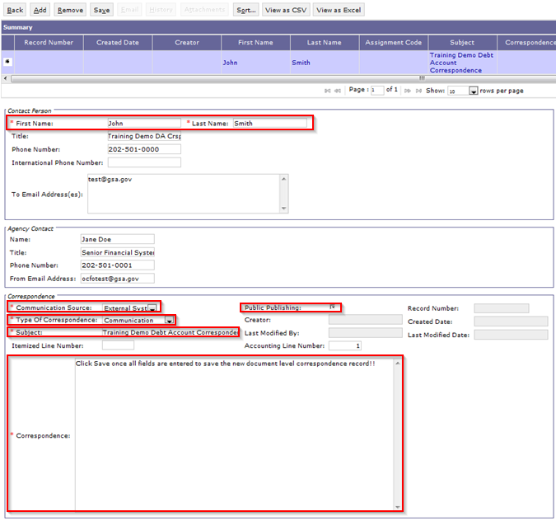
Debt Account Document Overview Correspondence

Slide 45
Debt Account Document Overview Correspondence
Field Name | Description
Contact Person Section
First/Last Name | The first/last name of the Debtor.
Title | The job title of the Debtor.
Phone Number | The phone number of the Debtor.
To Email Address(es) | The email address(es) of the Debtor and to which the correspondence should be emailed (if the GSA/USDA user utilizes the correspondence email capability).
Agency Contact Section
Name | The user ID of the GSA/USDA contact creating the record.
Title | The job title of the GSA/USDA contact.
Phone Number | The phone number of the GSA/USDA contact.
From Email Address | The email address of the GSA/USDA contact.
Correspondence Section
Communication Source | A dropdown box containing communication mediums. Options include: External System, FAX, Mail or Email, and Phone
Type of Correspondence | A dropdown box containing correspondence types. Options include: Resolution, Communication, Question, Chargeback, Chargeback Resolution, Dispute, and Other.
Subject | The subject header used to describe the correspondence.
Correspondence | Text field used to enter any text/information relating to the correspondence record.
Public Publishing Flag | This flag is set to false for Debt Account correspondence. DA correspondence is not transmitted to VCSS.

Slide 46
Dunning
Claim Initiation
Process

Slide 47
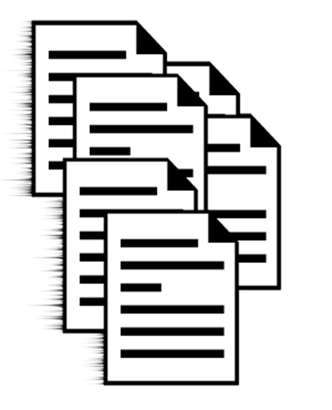


Claim Initiation Process
Establishing a Claim in Pegasys
Manual Entry
Region 7
Program Office
All Claim Types
Region 6
Program Office
FedPay/TAP/AutoPay
Others
Non-Program Office
Payroll
Vendor
Automated Interface
Region 6
Vehicle Claim Interface

Slide 48
Claim Initiation Process – Region 6 Vehicle Claims
Region 6 Vehicle Claim Interface
Automated processing of the Debt Account document via the Vehicle Claims interface Form Import batch process
Interface process initiated by GSA Comprehensive Accident Reporting Systems (CARS)
Form Import Batch Job ID: VHCLMGSIMPORT
Response Files
CARS System
Interface Source File
FMESB
Pegasys Batch Controls Process
Pegasys Form Import
Pegasys Debt Account Tables
Response Files

Slide 49
Claim Initiation Process – Region 7 Manual Entry
Region 7 Manual Claim Entry
User will manually process a Debt Account document to initiate the claim:
Document Type = D7M
Process an expense reclassification
Document Type = PU
Debt Account Header Tab:
PRG or GSA initiates the Debt Account entry (recorded via Claim Type field)
UDF 10 – Labeled Debt Account Type Detail – Required via Extensibility
Valid values include: CONSTRUCT, LEASE, DIRECTPAY, NONRECUR, RECURRING, UTILITIES
Record the PU document number in the Description field
Debtor Tab:
Populate the Vendor Code/Vendor Address Code associated to the Debtor
Debt Account Group value defaulted:
R7CLAIMS

Slide 50
Claim Initiation Process – Region 7 Manual Entry
Region 7 Manual Claim Entry (cont.)
Accounting Line Tab:
Transaction Type = 01
For Debt Accounts with a Claim Type value = GSA, the following fields are backdated to the date the First Demand Letter was sent to the Debtor
Start Date
First Demand Letter Generated Date
IPA Deferred Date
Interest Begin Date
Penalty Begin Date
Admin Charge Begin Date
For Debt Accounts with a Claim Type value = PRG:
Dunning Print Flag = F (only for the first 60 days)
Date fields populated as follows:
Start Date = Current Date
First Demand Letter Generated Date = 60 days in the future
IPA Deferred Date = 60 days in the future
Interest Begin Date = 60 days in the future
Penalty Begin Date = 60 days in the future
Admin Charge Begin Date = 60 days in the future

Slide 51
Claim Initiation Process – Region 7 Manual Entry
Region 7 Manual Claim Entry (cont.)
Accounting Line Tab (cont.):
If Program = PG53, the Lease Number must be populated
Type of Claim recorded via Receivable Type (see full list in prior slides)
Expenditure vs. Revenue Claims
Expenditure Claims = populate Sub-Object Class (SOC)
Revenue Claims = populate Revenue Source Code (RSC)
Full list of Receivable Type delineation:
R7CLAIMS Text Code used for all Region 7 Claims Receivable Types
Enter a Claim Description in the Comments to Print field to be displayed on Demand Letter/subsequent dunning notices
Type | Receivable Type
Expenditure | FRCLAIMR7, LDCLAIMR7, DPCLAIMR7, ETCLAIMR7, EPCLAIMR7, LTCLAIMR7, RSCLAIMR7, UCCLAIMR7
Revenue | CDCLAIMR7, PRCLAIMR7, STCLAIMR7

Slide 52
Claim Initiation Process – Region 6 Manual Entry
Region 6 Manual Claim Entry
Region 6 notified by Program Office for Program Office Claims and Finance by Non-Program Office Claims
User will manually process a Debt Account document to initiate the claim:
Document Type = D6M (Region 6)
Document Type = DES (External Services)
Process an expense reclassification for the following Claim Types:
VNCLAIMR6, FPCLAIMR6, TACLAIMR6, ECCLAIMR6, PRCLAIMR6, and APCLAIMR6
IP Document Type = PU
Reverse PAR Receivable for Region 6 Payroll Claims (PRCLAIMR6)
SV Document Type = D6A
Note: Claims are not generated for Claim Types RPCLAIMR6 or NCCLAIMR6 (for collections-only processing)
Note: External Services only creates payroll claims, Receivable Type PRCLAIMR6
Notes:
All Claims – Debt Account Start Date, Demand Letter Generation, and IP&A Deferred Date equals date the first demand letter was generated
ADD DATE SLIDE prior to Region 6 and Region 7 slides

Slide 53
Claim Initiation Process – Region 6 Manual Entry
Region 6 Manual Claim Entry (cont.)
Debt Account Header Tab:
External System ID
CARS (Vehicle Claims)
R6CLAIMMNL (All other Region 6 Claims)
Record the PU/D6A document number in the Description field, if applicable
UDF 10 – labeled Referral Options – valid values below:
Referral Options | Abbreviation
Accounts Payable | AP
Civilian Board of Contract Appeals | CIVBOCA
Contracting Officer | CO
DOJ | DOJ
DOJ (CCLR) | DOJCCLR
Fleet Management Center | FMC
GAO | GAO
Inspector General | IG
Legal | LEGAL
Legal (CCLR) | LEGALCCLR
OPM | OPM
Other Payroll | OTHER
Payroll | PAYROLL
Payroll Policy | PAYPOL
Personnel | PERSONNEL
Notes:
All Claims – Debt Account Start Date, Demand Letter Generation, and IP&A Deferred Date equals date the first demand letter was generated
ADD DATE SLIDE prior to Region 6 and Region 7 slides

Slide 54
Claim Initiation Process – Region 6 Manual Entry
Region 6 Manual Claim Entry (cont.)
Debtor Tab:
Populate the Vendor Code/Vendor Address Code associated to the Debtor
Debt Account Group value defaulted:
R6CLAIMS (Region 6)
ESCLAIMS (External Services)
Accounting Line Tab:
Transaction Type = 01
Program Office ONLY: The following fields are backdated to the date the First Demand Letter was sent to the Debtor
Start Date
First Demand Letter Generated Date
Interest Begin Date
Penalty Begin Date
Admin Charge Begin Date
Notes:
All Claims – Debt Account Start Date, Demand Letter Generation, and IP&A Deferred Date equals date the first demand letter was generated
ADD DATE SLIDE prior to Region 6 and Region 7 slides

Slide 55
Claim Initiation Process – Region 6 Manual Entry
Region 6 Manual Claim Entry (cont.)
Accounting Line Tab (cont.):
Type of Claim recorded via Receivable Type (see full list in prior slides)
Expenditure vs. Revenue Claims
Expenditure Claims = populate Sub-Object Class (SOC)
Revenue Claims = populate Revenue Source Code (RSC)
Full list of Receivable Type delineation:
FedPay, TAP, and AutoPay Claims (FPCLAIMR6, TACLAIMR6, and APCLAIMR6 respectively) follow a different process flow and will be discussed in greater detail in Segment 8
Type | Receivable Type
Expenditure | VNCLAIMR6, PRCLAIMR6, ECCLAIMR6
Revenue | WSCLAIMR6, VEHCLAIM, ADCLAIMR6, AUCLAIMR6, FICLAIMR6, IFCLAIMR6, LDCLAIMR6,
Notes:
All Claims – Debt Account Start Date, Demand Letter Generation, and IP&A Deferred Date equals date the first demand letter was generated
ADD DATE SLIDE prior to Region 6 and Region 7 slides

Slide 56
Claim Initiation Process – Region 6 Manual Entry
Region 6 Manual Claim Entry
Accounting Line Tab (cont.):
Region 6 Text Codes:
Enter a Claim Description in the Comments to Print field to be displayed on Demand Letter/subsequent dunning notices
Text Code | Receivable Type
R6POCLAIMS | ADCLAIMR6, AUCLAIMR6, APCLAIMR6, ECCLAIMR6, FPCLAIMR6, FICLAIMR6, IFCLAIMR6, LDCLAIMR6, TACLAIMR6, VEHCLAIM
R6PRCLAIMS | PRCLAIMR6
R6CLAIMS | VNCLAIMR6, WSCLAIMR6
Notes:
All Claims – Debt Account Start Date, Demand Letter Generation, and IP&A Deferred Date equals date the first demand letter was generated
ADD DATE SLIDE prior to Region 6 and Region 7 slides

Slide 57
Claim Initiation Process – Expense Reclassification
Expense Reclassification Process:
Manual processing of a payment document to reclassify expense:
Document Category IP
Document Type PU
PU Accounting Line “Claim Number” field provides link back to Pegasys Debt Account Number
PU Document Organization:
Line 1: credit referencing original order that incurred erroneous charge
Line 2: expense reclassification without document reference

Slide 58
Claim Initiation Process – Expense Reclassification
Region 6 Processing –
Processed for the following claims Receivable Types:
Vendor (VNCLAIMR6), FedPay (FPCLAIMR6), TAPS (TACLAIMR6), Excess Cost (ECCLAIMR6) and Autopay (APCLAIMR6) claims ONLY
Region 6 PU Document Organization:
Line 1: credit referencing the original order that incurred the erroneous charge:
TT = 10 for expense reclassification related to VNCLAIMR6 claims
TT = 11 for expense reclassification related to:
FPCLAIMR6, TACLAIMR6, ECCLAIMR6, APCLAIMR6 claims
Line 2: expense reclassification without a document reference:
TT = 14 for expense reclassification related to VNCLAIMR6 claims
TT = 15 for expense reclassification related to:
FPCLAIMR6, TACLAIMR6, ECCLAIMR6, APCLAIMR6 claims

Slide 59
Claim Initiation Process – Expense Reclassification
Expense Reclassification Process (Cont.)
Applies to ALL Region 7 claim Receivable Types
Region 7 PU Document Organization
Line 1: credit referencing the original order that incurred the erroneous charge (except for Lease claims, where original order is not referenced) :
TT = 11 for Program Code PG80
TT = 10 for all other Program values
TT = I3 for interest relating to a claim
Line 2: expense reclassification without a document reference:
TT = 14 (non-reimbursable)
TT = 15 (reimbursable)
Must use Function Code PG931

Slide 60
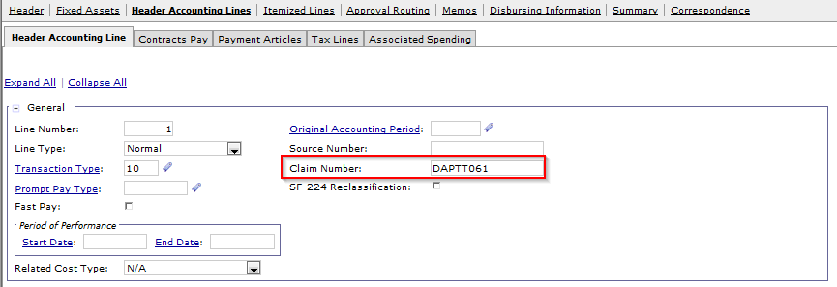
Claim Initiation Process – Expense Reclassification
Expense Reclassification Process (Cont.)
The Claim Number field on the PU accounting line must be populated with the Debt Account Number.

Slide 61
Claim Initiation Process – Expense Reclassification
Expense Reclassification Process (Cont.)
Header UDF1, which is labeled Assignment Code, will be used to distinguish between Region 6 and Region 7 PU documents.
Valid values are:
R6CLAIMS
R7CLAIMS
A relationship edit is configured to require the entry of a value in this field.

Slide 62
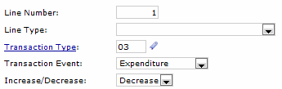
Claim Initiation Process – Reverse PAR Receivable
Reverse PAR Receivable – Region 6 Payroll Claims ONLY
Processed to ensure claim receivable is not double booked in PAR and Pegasys as result of processing Debt Account document
PAR Reversal SV reverses claim receivable originally processed via PAR
The Reverse PAR Receivable process applies only to Region 6 Payroll Claims, and NOT External Services Payroll Claims
Document Category = SV
Document Type = D6A
Transaction Type = 03
Line Type = Blank
Transaction Event = Expenditure
Increase/Decrease Indicator = Decrease

Slide 63
Dunning
Debt Account
Entity & Queries

Slide 64
Debt Account Entities and Queries
Debt Account Entity:
Established once the initial Debt Account document is processed
Identified by the unique Debt Account Number
Pegasys utilizes the entity model to track the relationship between the DA entity and:
Subsequent updates to the entity
Individual downstream transactions referencing the DA entity
Any subsequent corrections to the Debt Account entity are performed via an Amendment
1
2
3
Initial Debt Account Creation
(06/11/2015)
Line Amount Increase of $100
(06/17/2015)
Correction of the Revenue Source Code – (RSC)
(07/02/2015)
DA Amendment #1
DAV201506110001
Debt Account #: 6111579
New DA Document
DAV201506110001
Debt Account #: 6111579
DA Amendment #2
DAV201506110001
Debt Account #: 6111579
Debt Account Entity (Debt Account #: 6111579)

Slide 65
Debt Account Entities and Queries
Debt Account Query: The primary resource for managing/tracking the claim after the Debt Account document has been processed to initiate the claim
All activity for a given Debt Account references the Debt Account Entity, NOT the Debt Account document
1
Initial Debt Account Creation
(07/02/2015)
2
3
Process partial Debt Account Collection
(07/12/2015)
Process Write-Off CR for outstanding balance
(10/27/2015)
L6X Cash Receipt
$198
Update DA Entity Outstanding and Collected Amounts
Debt Account #: 7175909
New DA Document
$200
Debt Account #: 7175909
NW6 Cash Receipt
$2
Update DA Entity Outstanding and Write-Off Amounts
Debt Account #: 7175909
Debt Account Entity (Debt Account #: 7175909)

Slide 66
Debt Account Entities and Queries
List of downstream transactions referencing the DA Entity:
Document Category | Document Type
 | Region 6 | Region 7
Collection CRs | L6X, PC6, PE6, CH6, EF6, CA6 | L7M, PC7, CH7, EF7, CA7
Write-Off CRs | NW6 | NW7
Refund IPs | MR6 | MR7

Slide 67
Debt Account Entities and Queries
Users will use the following queries to research the Pegasys Debt Account Entity:
Debt Account Query
Debt Account by Debt Account Group Query
The Debt Account Query allows users to seamlessly perform the following actions against the Debt Account Entity:
Review a snapshot of the Debt Account Entity, including original amounts owed, amounts collected, amounts outstanding, overdue charges, etc.
Review all Pegasys transactions referencing the Debt Account Entity
Update the Debt Account Entity from the Query
Initiate Collections transactions
View and Add Attachments
Attachments are added to a Debt Account entity following the same steps reviewed for adding attachments to documents

Slide 68
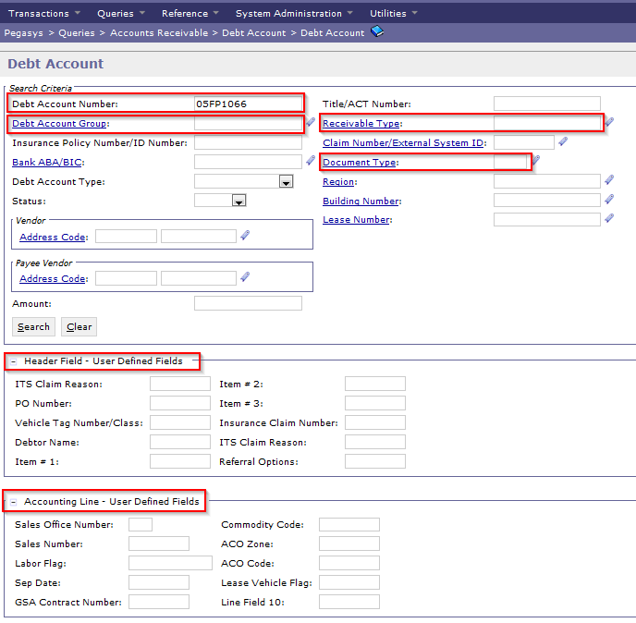
Debt Account Entities and Queries
To access the Debt Account Query, navigate to Queries > Accounts Receivable > Debt Account > Debt Account
Popular search criteria, including:
Debt Account Number
Debt Account Group
Receivable Type
Document Type
Header and Accounting Line UDFs

Slide 69
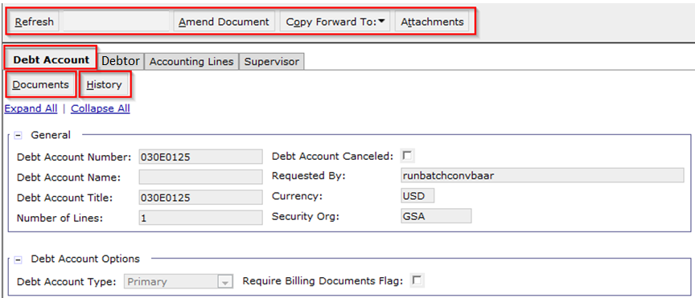
Debt Account Entities and Queries
The Debt Account Query details page opens to the Debt Account Tab
From this screen, users can:
Refresh the query
Amend the Debt Account Entity
Opens the DA document used to create the Debt Account Entity in Amend mode
Copy Forward To a Cash Receipt – initiate manual collection or write-off processing
View the Documents and History associated with the Debt Account Entity

Slide 70
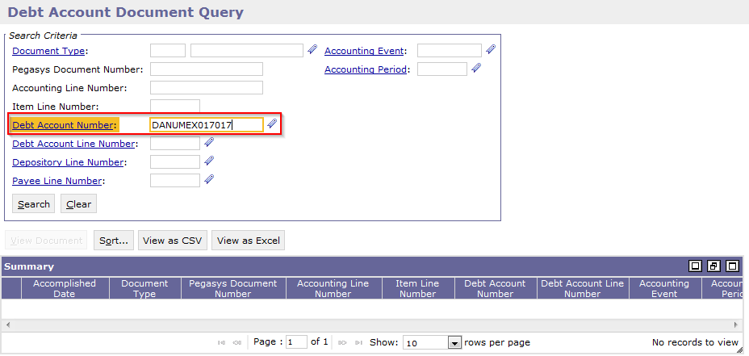
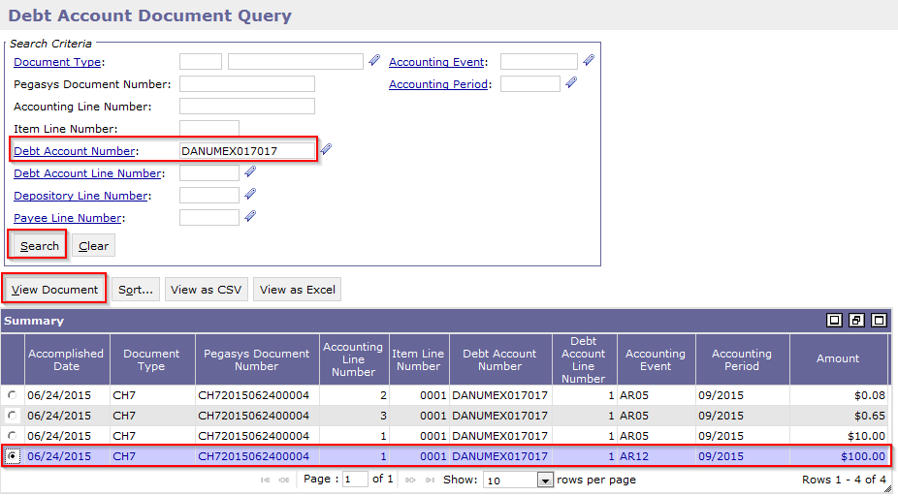
Debt Account Entities and Queries
Debt Account Entity Documents page
Documents Button
View all Documents referencing the Debt Account Entity
The Debt Account Number is pre-populated.
Users may enter additional criteria to limit the search, e.g.:
Enter document type = L6X to return only Region 6 Claims Lockbox transaction
Enter Accounting Period to search for documents processed only during the current period

Slide 71
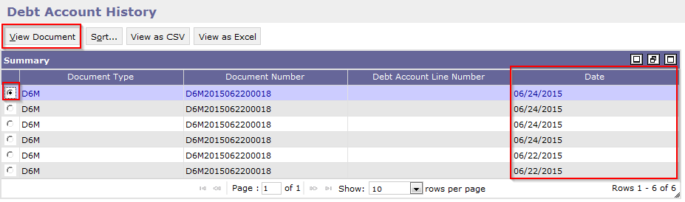
Debt Account Entities and Queries
Debt Account Entity History page
History Button
View the Amendment history associated to the Debt Account Entity
The Date Column allows users to:
View the date the DA Entity was established
Review the subsequent dates on which the DA Entity was amended
Once a record is selected, the View Document button may be utilized to view the Debt Account document

Slide 72
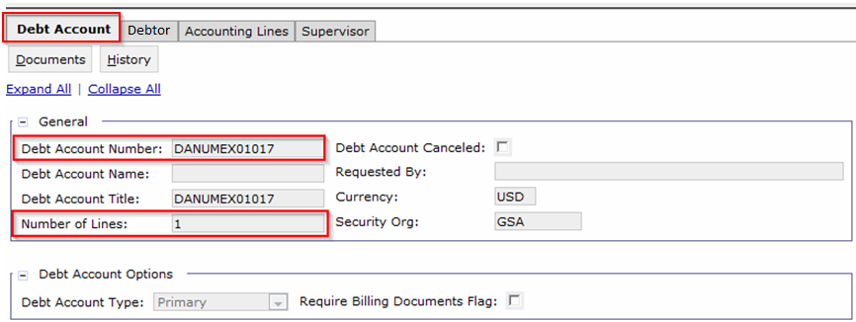
Debt Account Entities and Queries
Debt Account Tab
Debt Account Number:
This is the unique number identifying the Debt Account entity. The value is populated on the Debt Account document when the DA Entity is initially established. All amendments and downstream transactions will reference the Debt Account Number
Number of Lines:
Indicates the number of accounting lines on the Debt Account entity

Slide 73
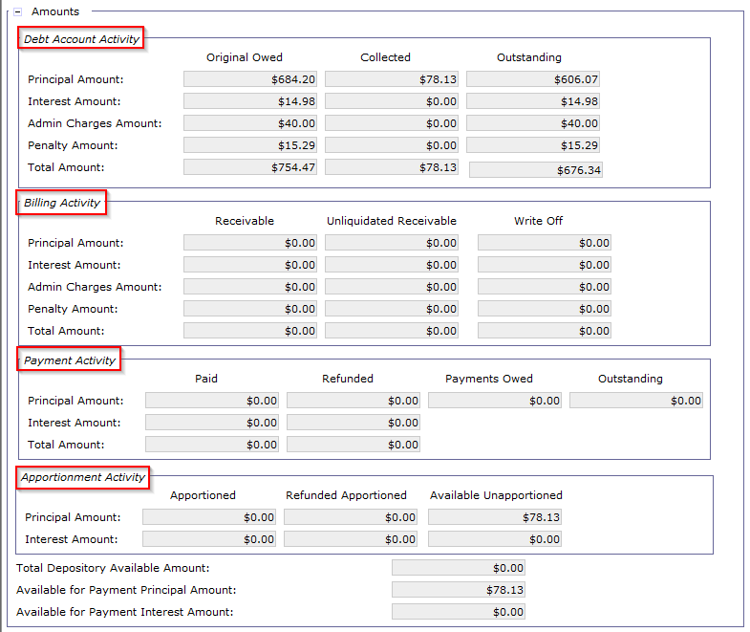
Debt Account Entities and Queries
Debt Account Tab (cont.)
Debt Account Activity
Displays Original, Collected, and Outstanding Principal and IP&A amounts
Billing Activity
Will only utilize this section to record/view the ‘Write-Off’ column amounts
The first two columns are not used
Payment Activity
Will only use the ‘Refunded’ column for amounts refunded to the Debtor
Apportionment Activity
Will not utilize this section
Notes:
Note: GSA only records a single debtor on the Debt Account entity. As such, the full collection amount is apportioned to the sole debtor.

Slide 74
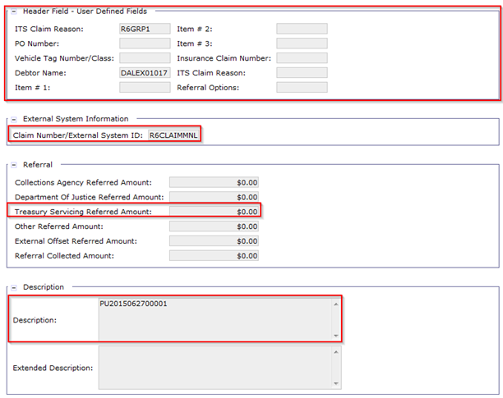
Debt Account Entities and Queries
Debt Account Tab (cont.)
Header User Defined Fields
Provides searchable/viewable UDF info for the DA
External System Information
Displays the External System ID/Claim Type associated to the DA
Referral
Will track the Treasury Servicing Referred Amounts
Description
Enter pertinent info, e.g. PU Document Number
Notes:
Note: GSA only records a single debtor on the Debt Account entity. As such, the full collection amount is apportioned to the sole debtor.

Slide 75
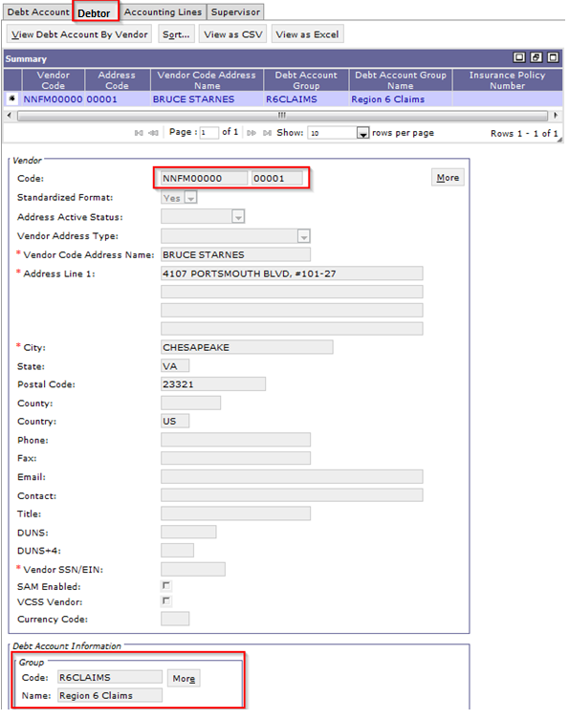
Debt Account Entities and Queries
Debtor Tab
Displays the debtor information associated to the Debt Account, including:
Vendor Code
Vendor Address Code
Vendor Address and Contact Info
Debt Account Group
This value is pulled from the Debt Account Group maintenance table.
Valid values are:
R6CLAIMS
R7CLAIMS
ESCLAIMS
Will use this field in conjunction with the Debt Account by Debt Account Group query to facilitate summary level search capabilities at the Debt Account Group level
Notes:
Note: GSA only records a single debtor on the Debt Account entity. As such, the full collection amount is apportioned to the sole debtor.

Slide 76
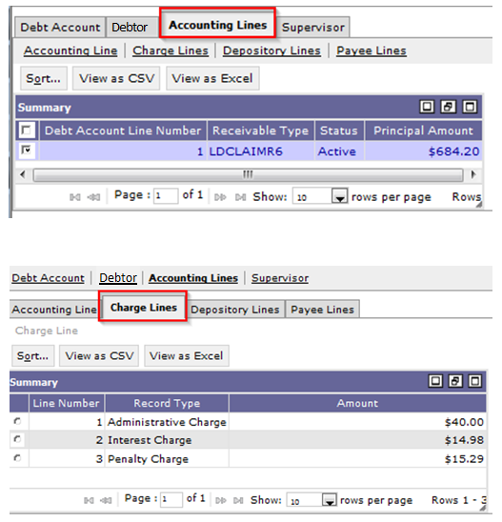
Debt Account Entities and Queries
Accounting Lines Tab
The accounting lines tab allows users to:
Query/view the information displayed on the DA Entity accounting line, including:
Dunning Count/Amount
Amortization Schedule
Debt Appeal Forbearance Flag
IP&A Begin Date and Type
Comments to Print
Review the IP&A charge lines assessed on the Debt Account line
Notes:
Note: GSA only records a single debtor on the Debt Account entity. As such, the full collection amount is apportioned to the sole debtor.

Slide 77
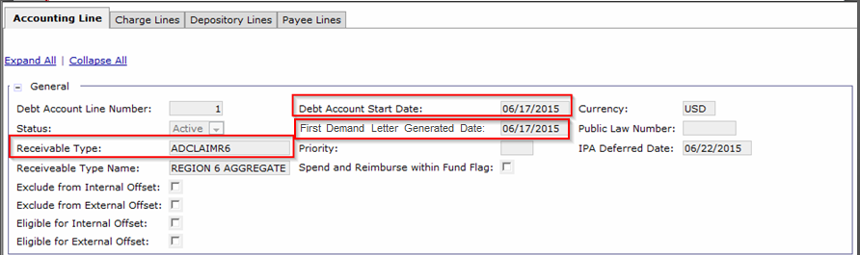
Debt Account Entities and Queries
Accounting Lines Tab (cont.)
General Section
Receivable Type
Records the Region 6/Region 7 Claim Type
Debt Account Start Date
Set equal to the First Demand Letter Generated Date
First Demand Letter Generated Date
The date the First Demand letter was sent to the Debtor
Notes:
Note: GSA only records a single debtor on the Debt Account entity. As such, the full collection amount is apportioned to the sole debtor.

Slide 78
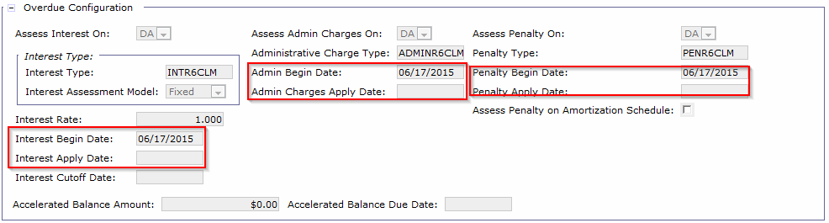
Debt Account Entities and Queries
Accounting Lines Tab (cont.)
Overdue Configuration
Interest, Admin, Penalty Begin Dates
Set equal to the First Demand Letter Generated Date
Interest, Admin Charges, Penalty Apply Date
The last date IP&A was assessed against the DA Entity
Notes:
Note: GSA only records a single debtor on the Debt Account entity. As such, the full collection amount is apportioned to the sole debtor.

Slide 79
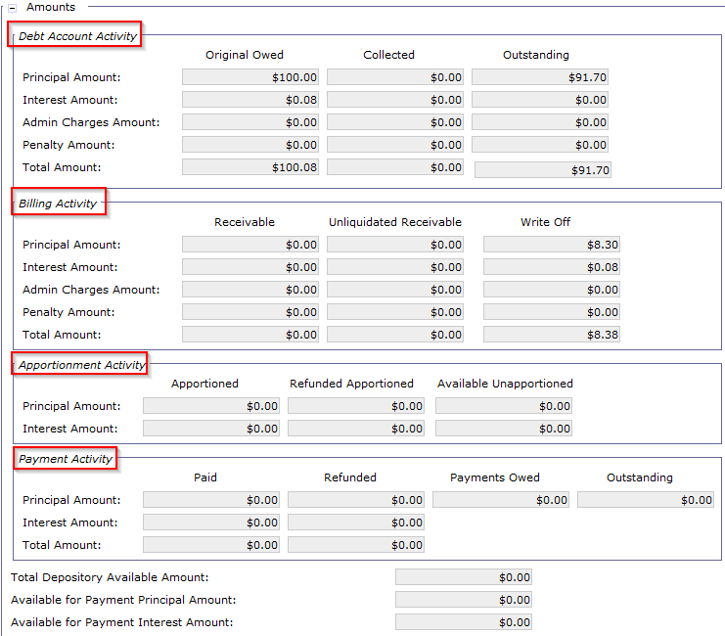
Debt Account Entities and Queries
Accounting Lines Tab (cont.)
Amounts
Debt Account Activity
Records Original, Collected, and Outstanding DA amounts
Billing Activity
Only use this section to record Write-Off amounts
Apportionment Activity
This section is updated by collections referencing the DA Entity, but this section will not be used
Payment Activity
Only use this section to record the Refunded amounts
Notes:
Note: GSA only records a single debtor on the Debt Account entity. As such, the full collection amount is apportioned to the sole debtor.

Slide 80
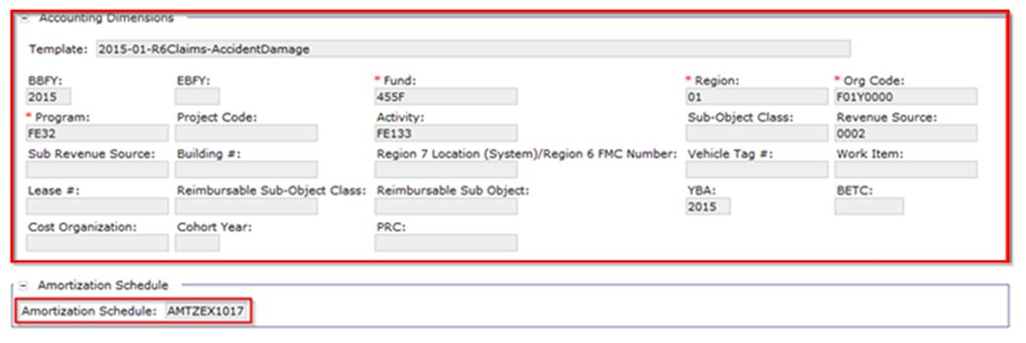
Debt Account Entities and Queries
Accounting Lines Tab (cont.)
Accounting Dimensions
Records the Accounting Template, Fund, BBFY, Program, Activity, Sub-Object Class, Revenue Source Code, etc.
Amortization Schedule
Review any amortization schedule associated to the DA Entity
Notes:
Note: GSA only records a single debtor on the Debt Account entity. As such, the full collection amount is apportioned to the sole debtor.

Slide 81
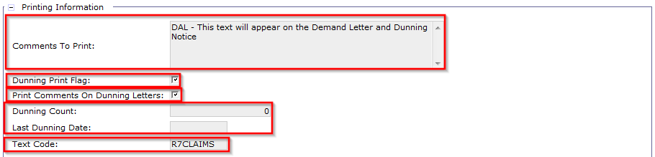
Debt Account Entities and Queries
Accounting Lines Tab (cont.)
Comments to Print
Used by Region 6/Region 7 to include additional information to print to the Demand Letter/Dunning Notice not already included in the pre-configured text codes
Dunning Print Flag/Print Comments on Dunning Letters
Determine if the DA Entity is eligible for Dunning/to print comments
Dunning Count/Last Dunning Date
Allow users to review how many times and the last date on which the Debtor has been dunned
Text Code
Determines the text to be printed to the Demand Letter/Dunning Notice
Notes:
Note: GSA only records a single debtor on the Debt Account entity. As such, the full collection amount is apportioned to the sole debtor.

Slide 82
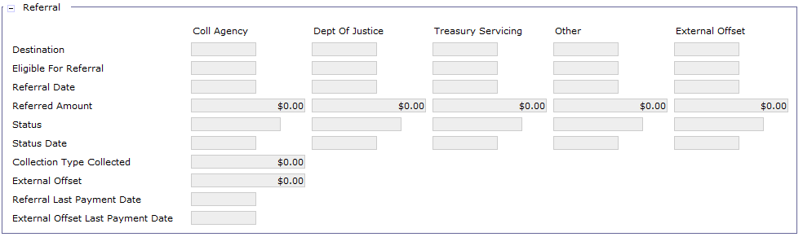
Debt Account Entities and Queries
Accounting Lines Tab (cont.)
Referral
The Referral button allows users to review any referred Debt/important dates/amounts
Notes:
Note: GSA only records a single debtor on the Debt Account entity. As such, the full collection amount is apportioned to the sole debtor.

Slide 83
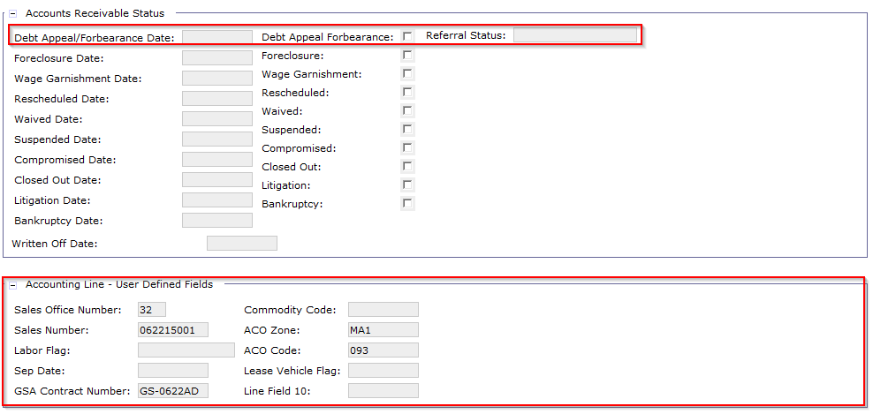
Debt Account Entities and Queries
Accounting Lines Tab (cont.)
Accounts Receivable Status
Debt Appeal/Forbearance Date/Flag
Allows users to review DA Entity under dispute/having DAFF set equal to True
Accounting Line User Defined Fields
Provide additional detail specific to the Debt Account
Notes:
Note: GSA only records a single debtor on the Debt Account entity. As such, the full collection amount is apportioned to the sole debtor.

Slide 84
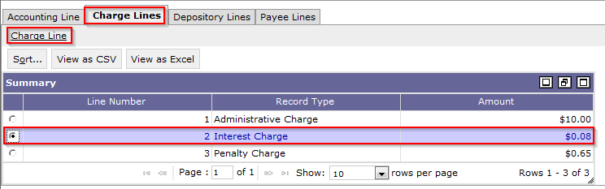
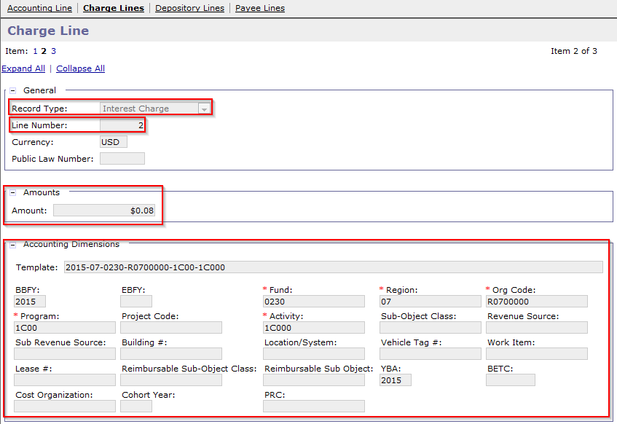
Debt Account Entities and Queries
Accounting Lines Tab (cont.)
Charge Lines
Users may review any associated Interest, Penalty, and/or Admin Charge lines on the accounting line
Selecting the charge line and clicking the Charge Line hyperlink opens the detail screen including:
Record Type (Interest, Penalty, or Admin Charge)
Transaction Type
Amounts
Accounting Dimensions
Notes:
Note: GSA only records a single debtor on the Debt Account entity. As such, the full collection amount is apportioned to the sole debtor.

Slide 85
Debt Account Entities and Queries
Users will also use the Debt Account by Debt Account Group Query to:
Search all open claims by Debt Account Group and view claims by Region:
Region 6 Claims – R6CLAIMS, ESCLAIMS (External Services)
Region 7 Claims – R7CLAIMS
Review summary Debt Account Group Information by:
All Vendors (Debtors) within the Debt Account Group
All claims Receivable Types within the Debt Account Group
All Debt Accounts within the Debt Account Group
Provides a direct link to the Debt Account Query

Slide 86
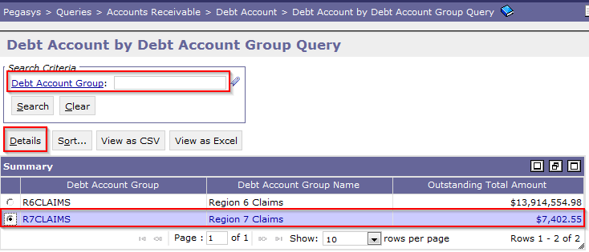
Debt Account Entities and Queries
To access the Debt Account by Debt Account Group Query, navigate to Queries > Accounts Receivable > Debt Account > Debt Account by Debt Account Group Query
Users may limit the search criteria to a specific Debt Account Group
Once the search is completed, users may select the Debt Account Group from the item collection and click the Details button to review the summary info at the Debt Account Group level
The query returns the following information:
Debt Account Group
Debt Account Group Name
Outstanding Total Amount – This is the summary outstanding amount for all DA Entities associated to the DA Group

Slide 87
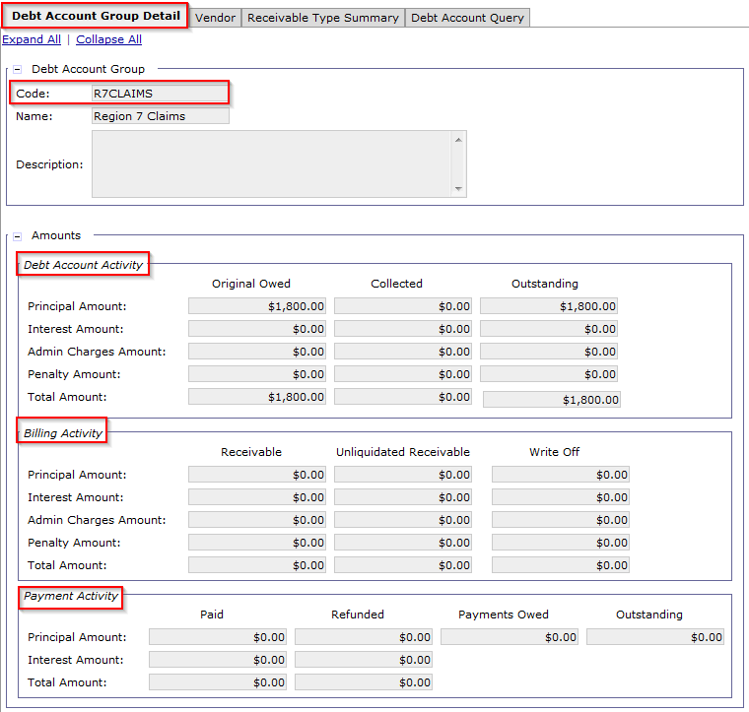
Debt Account Entities and Queries
Debt Account Group Detail
Displays the following balances associated to the Debt Account Group code:
Debt Account Activity
Review Original, Collected, and Outstanding Debt Account Amounts
Billing Activity
Will only utilize the Write-Off Amounts column
Payment Activity
Will only utilize the Refunded Amount column
Debtor

Slide 88
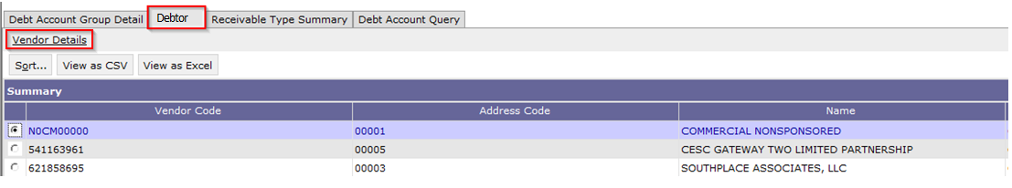
Debt Account Entities and Queries
The Debtor tab returns all Vendor Codes/Vendor Address Codes populated on Debt Accounts within the Debt Account Group
Selecting a record and clicking the Vendor Details hyperlink will display the following:
Vendor Code/Address Code/Name
Debt Account Activity, Billing Activity, and Payment Activity amounts summarized for the selected vendor (debtor)

Slide 89
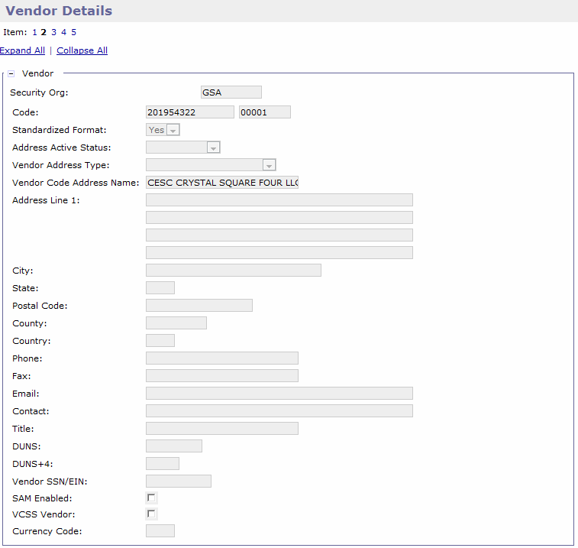
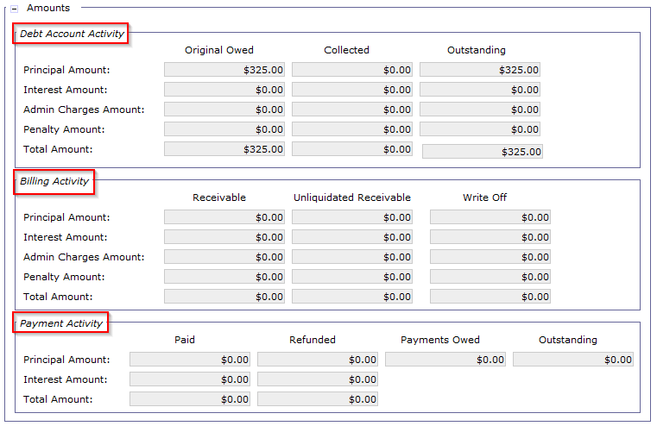
Debt Account Entities and Queries
The Debtor Details page displays:
Vendor Information
Vendor Code, Address Code, Name, City, State, etc.
Summary Amounts for the Vendor

Slide 90
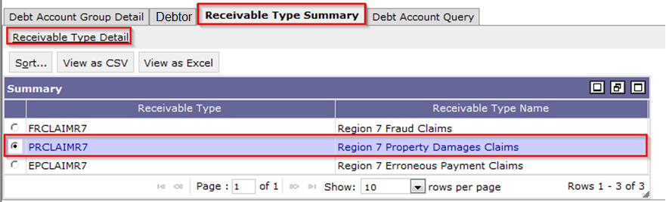
Debt Account Entities and Queries
The Receivable Type Summary tab returns summary level information for all Receivable Types included on Debt Accounts within the Debt Account Group
Selecting a record and clicking the Receivable Type Summary hyperlink will display the following:
Debt Account Activity, Billing Activity, and Payment Activity amounts summarized for the selected Receivable Type

Slide 91
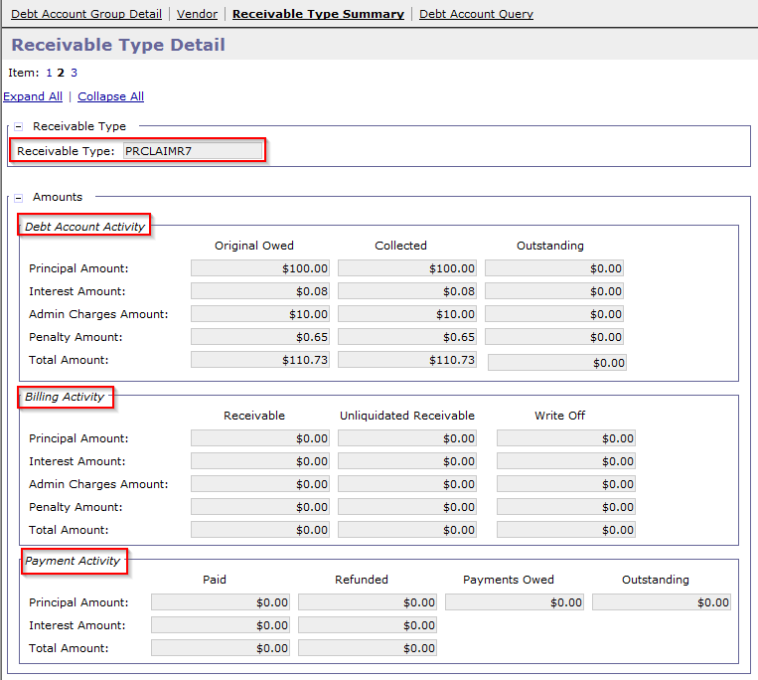
Debt Account Entities and Queries
The Debtor Details page displays:
Summary Amounts for the Receivable Type

Slide 92
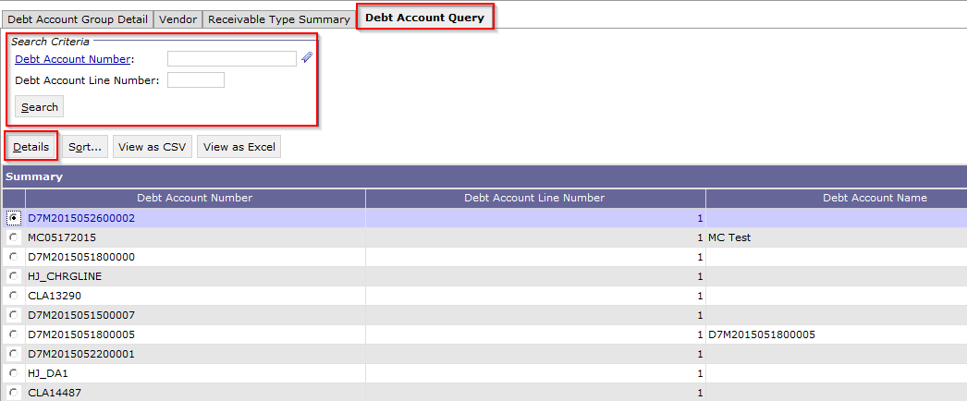
Debt Account Entities and Queries
The Debt Account Query tab returns ALL Debt Account Numbers associated to the Debt Account Group
Provides users the option to open the Debt Account Query record by clicking the Details button
All Debt Accounts Numbers associated to the Debt Account Group will be pre-populated, but users may enter the Debt Account Number to narrow the scope of the search

Slide 93
Exercise
Exercise 1: Create a Debt Account and review the entity via the Debt Account Query
Notes:
Remove blue box…single bullet

Slide 94
Dunning
Segment 3:
Internal Offsets

Slide 95
Table of Contents
Segment 1: Debt Account Overview
Segment 2: Debt Account Creation
Segment 3: Internal Offsets
Internal Offsets Overview
Segment 4: First Demand Letter
Segment 5: Promissory Note Process
Segment 6: Collection from Debtor
Segment 7: Delinquency & Receivables Management
Segment 8: FedPay/TAP/AutoPay – Special Procedures
Segment 9: Debt Account Reports
Segment 10: Mass Import

Slide 96
Dunning
Internal Offsets
Overview

Slide 97
Internal Offsets
Purpose – Offset undisbursed payments or lease profiles with outstanding Debt Accounts, allowing users to avoid sending a payment to a vendor who also owes money to GSA via a claim
Manual Internal Offset process:
Users may manually research and enter Internal Offset transactions
Document Type = IOF
Internal Offset Transaction:
Single Cash Receipt with 1 accounting line referencing the Debt Account entity:
Line Type = Normal
Transaction Type:
Debt Account without Amortization Schedule:
C01 – All Receceivable Types except FedPay/TAP/AutoPay
C02 – FedPay/TAP/AutoPay Receivable Types
Debt Account with Amortization Schedule:
P01 – Used for all Receivable Types (inclusive of FedPay/TAP/AutoPay)

Slide 98
Internal Offset Procedures
Two Standard Internal Offset Procedures:
Accounts Payable
Lease
Accounts Payable Procedures
Pre-conditions: An Undisbursed Payment exists for the same vendor for which a claim will later be established
Step 1:
USDA Finance Accounts Payable personnel notifies USDA Finance Claims personnel to manually generate a Debt Account to record the claim against a Debtor
Step 2:
USDA Finance Claims identifies the Undisbursed Payment from the pre-conditions and notifies USDA Accounts Payable of the need to offset
Step 3:
USDA Finance Accounts Payable corrects the undisbursed payment per the regional desk guides or standard operating procedures for offsets

Slide 99
Internal Offsets Procedures
Accounts Payable Procedures
Step 4:
USDA Finance Accounts Payable notifies USDA Finance Claims that the Undisbursed Payment has been offset and the Debt Account processed in Step 1 may now be offset for that amount
Step 5:
USDA Finance Claims processes an IOF Cash Receipt to record the offset
Note: This process will be covered in detail on the following slides.

Slide 100
Internal Offsets Procedure – Lease
Two Standard Internal Offset Procedures:
Accounts Payable
Lease
Lease Procedures
Pre-conditions: A Region 7 lease profile exists for the same vendor for which a claim will later be established
Step 1:
USDA Finance Accounts Payable personnel notifies USDA Finance Claims personnel to manually generate a Debt Account to record the claim against a Debtor
Step 2:
USDA Finance Claims identifies the Lease Profile from the pre-conditions and notifies USDA Accounts Payable of the need to offset the Debt Account with future payments from the lease profile
Step 3:
USDA Finance Region 7 Lease personnel corrects the Lease Profile to apply a withhold, which either reduces the amount of the next payment or prevents the generation of a certain number of future payments

Slide 101
Internal Offset Procedure – Lease
Lease Procedures
Step 4:
USDA Finance Region 7 Lease notifies USDA Finance Claims of the withhold for the requested amount and the Debt Account processed in Step 1 may now be offset for that amount
Step 5:
Option 1: Offset Full Claim Amount Immediately
USDA Finance Claims processes an IOF Cash Receipt to record the offset for the full Claim offset amount
Option 2: Monthly Scheduled Offset Installments
USDA Finance Claims amends the Debt Account to set the Waive Interest/Penalty/Admin flags to True so no additional IP&A is generated during the offset period
Creates multiple scheduled IOF Cash Receipts each for the amount of the withheld lease payments to be processed on a future date by GSOFFLINE

Slide 102
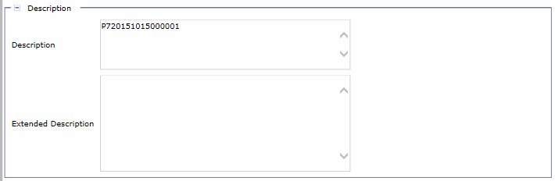
Internal Offsets – Creation
Users will manually Copy Forward To the IOF CR via the Debt Account Query
The Debt Account Entity reference will automatically be populated
Populate Undisbursed Payment Document Number or Lease Number in Description field.
\

Slide 103
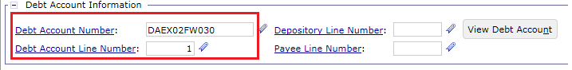
Internal Offsets – Creation
Accounting Line 1:
References Debt Account Entity
Transaction Type:
Debt Account without Amortization Schedule:
C01 – All Receceivable Types except FedPay/TAP/AutoPay
C02 – FedPay/TAP/AutoPay Receivable Types (covered in Segment 8)
Debt Account with Amortization Schedule:
P01 – Used for all Receivable Types (inclusive of FedPay/TAP/AutoPay)
Line Type = Normal
\

Slide 104

Internal Offsets – Updates to Debt Account
Updates to Debt Account Entity:
Increase of Collected Amount
Decrease of Outstanding Amount
\

Slide 105
Internal Offsets - Example
GSA sends a payment to Staples for purchase of office supplies
GSA later determines they overpaid Staples – GSA establishes a Debt Account
GSA purchases office products from Staples a 2nd time, processing a payment to be disbursed for this purchase
GSA offsets the undisbursed payment with the outstanding Debt Account via the IOF document

Slide 106
Exercise
Exercise 2: Manual entry of Internal Offset CR
Notes:
Remove blue box…single bullet

Slide 107
Dunning
Segment 4:
First Demand Letter and Subsequent Dunning Generation

Slide 108
Table of Contents
Segment 1: Debt Account Overview
Segment 2: Debt Account Creation
Segment 3: Internal Offsets
Segment 4: First Demand Letter and Subsequent Dunning Generation
First Demand Letter & Subsequent Dunning Notices
Segment 5: Promissory Note Process
Segment 6: Collection from Debtor
Segment 7: Delinquency & Receivables Management
Segment 8: FedPay/TAP/AutoPay – Special Procedures
Segment 9: Debt Account Reports
Segment 10: Mass Import

Slide 109
Dunning
First Demand Letter &
Subsequent Dunning Notices

Slide 110
First Demand Letter and Subsequent Dunning Notice
Pegasys provides users with the ability to:
Generate the First Demand Letter
This is the initial letter notifying the debtor of the new claim
Provides notice for the debtor to take action within 30 days at the risk of:
Incurring overdue interest, penalty, and administrative charges
GSA reporting the debt to the U.S. Treasury FMS Center for collection
Generate subsequent Dunning Notices
Sent out to the Debtor 30 days after the date of the First Demand Letter
The Claim is established
First Demand Letter sent to Debtor
Customer promptly remits payment within 30 days
ELSE: Subsequent Dunning Notice generated

Slide 111
First Demand Letter and Subsequent Dunning Notices
First demand letter notifying the debtor of the new claim
Note: Subsequent slides contain detailed timeline of demand letter generation
Region 6 Non-Program Office Claims and Region 7 Claims with GSA Claim Type: First Demand Letter sent same day the Debt Account is established in Pegasys
First Demand Letter generated/sent from Pegasys
Region 7 Claims with PRG Claim Type: First Demand Letter sent 60 days after the Debt Account Start Date
First Demand Letter generated/sent from Pegasys
Region 6 Program Office Claims: typically sent same day the Debt Account is established in Pegasys, but may include several day lag to process Debt Account
First Demand Letter generated/sent externally/directly from affiliated GSA Program Office
Lag: may be several day lag from day First Demand Letter sent by Program Office and day Debt Account document processed in Pegasys
FedPay/TAP/AutoPay Claims will be covered in Segment 8

Slide 112

First Demand Letter and Subsequent Dunning Notices
Text Codes
Text printed to the notice is determined by the Dunning Count, Text Code (R6POCLAIMS, R6PRCLAIMS, R6CLAIMS, R7CLAIMS), AND Comments to Print recorded on the DA Entity
Comments to Print
The “Comments to Print” field on the Debt Account is used to enter verbiage to be included on the printable Dunning Notice that is not already included in the pre-defined Text Code configuration

Slide 113
Delinquency Management - Dunning
Region 7 GSA Program Office timeline
4/1 First Demand Letter Sent from Pegasys
Program Office Claims
(assumes no lag)
April
May
June
4/1 Debt Package Sent to R7
5/1 Interest Assessed 4/1 – 4/30 in Peg
5/1 First Dunning Generated in Peg
6/1 IP&A Assessed 5/1–5/31 in Peg
6/1 2nd Dunning Generated in Peg
Notes:
Region 7 Program Office Timeline
-No lag days

Slide 114
Dunning – Region 7 Manual Entry (Cont.)
Region 7 PRG Program Office timeline
Program Office Claims
(assumes no lag)
April
May
June
July
August
6/1 First Demand Letter Sent from Pegasys
4/1 Debt Package Sent to R7
7/1 Interest Assessed 6/1 – 6/30 in Peg
7/1 Second Dunning Generated in Peg
8/1 IP&A Assessed 7/1–7/31 in Peg
8/1 Third Dunning Generated in Peg
Notes:
Region 7 Program Office Timeline
-No lag days

Slide 115
Delinquency Management - Dunning
Region 6: Program Office vs. Non-Program Office timeline discrepancy
Non-Program Office Claims
(assumes no lag)
4/1 First Demand Letter Sent from Peg
April
May
June
4/1 Debt Package Sent to R6
5/1 Interest Assessed 4/1 – 4/30 in Peg
5/1 2nd Dunning Generated in Peg
6/1 IP&A Assessed 5/1–5/31 in Peg
6/1 3rd Dunning Generated in Peg
Notes:
Non-Program Office Timeline

Slide 116
Delinquency Management - Dunning
Region 6: Program Office vs. Non-Program Office timeline discrepancy (Cont.)
4/1 First Demand Letter Sent from Program Office
Program Office Claims - Small Lag
(assumes lag < 30 days)
April
May
June
4/5 Debt Package Sent to R6
5/1 Interest Assessed 4/1 – 4/30 in Peg
5/1 First Dunning Generated in Peg
6/1 IP&A Assessed 5/1–5/31 in Peg
6/1 2nd Dunning Generated in Peg

Slide 117
Delinquency Management - Dunning
Region 6: Program Office vs. Non-Program Office timeline discrepancy (Cont.)
4/1 First Demand Letter Sent from Program Office
Program Office Claims - Large Lag
(assumes lag > 30 days)
April
May
June
5/15 Debt Package Sent to R6
5/15 Interest Assessed 4/1–5/1 in Peg
5/15 First Dunning Generated in Peg
6/1 IP&A Assessed 5/1–6/1 in Peg
6/15 2nd Dunning Generated in Peg

Slide 118
First Demand Letter and Subsequent Dunning Notices
Dunning Hierarchy
Non-Program Office
Program Office
Program Office
Region 6
Region 7
First Demand Letter Sent
Sent out of Pegasys
Sent out of Program Office
Sent out of Pegasys
Location of Letter Generation
Note: All subsequent Dunning Notices are generated and sent out of Pegasys
-FedPay/TAP/AutoPay will be covered in Segment 8

Slide 119
First Demand Letter and Subsequent Dunning Notices
Two step process to create First Demand Letter out of Pegasys:
ARDUNNING batch job – selects eligible Debt Accounts and generates PDF letter
Physical Generation – GSA/USDA prints and mails letters to each debtor
Several ARDUNNING batch instances are pre-configured. These instances distinguish:
The text/fields to be printed on the demand letter
Dunning Counts
Auto-generation of the demand letter
Receivable Types
A full list of the configured batch instances to generated the First Demand Letter may be found on the next slide

Slide 120
First Demand Letter and Subsequent Dunning Notices – Configured Batch Instances
Batch Instance | Receivable Types
All Region 7 Claims:
ARDUNNINGR7C1NF – Creates First Demand Letter to send to the Debtor | PRCLAIMR7, FRCLAIMR7, LDCLAIMR7, CDCLAIMR7, DPCLAIMR7, ETCLAIMR7, EPCLAIMR7, LTCLAIMR7, RSCLAIMR7, STCLAIMR7, UCCLAIMR7
Batch Instance | Receivable Types
Program Office Claims:
N/A – First Demand Letter Generated by Program Office | ADCLAIMR6, AUCLAIMR6, APCLAIMR6, ECCLAIMR6, FPCLAIMR6, FICLAIMR6, IFCLAIMR6, LDCLAIMR6, TACLAIMR6, VEHCLAIM
Standard Region 6 Claims:
ARDUNNINGR6C1NF | VNCLAIMR6, WSCLAIMR6
Payroll Claims:
ARDUNINGR6PR1NF | PRCLAIMR6
Notes:
Why do we break out the Batch Instances…introduction at high level on previous slide
Update Receivable Types recorded on Config guide

Slide 121

First Demand Letter and Subsequent Dunning Notices
Updates to Dunning Count and Last Dunning Date:
The following Claim Types WILL record an update to the Dunning Count and Last Dunning Date when the First Demand Letter is generated:
Region 7 Program Office
Region 6 Payroll
Region 6 Non-Program Office
The Dunning Count and Last Dunning Date are not updated for Region 6 Program Office claims when sending out the First Demand Letter
Users may review the Dunning Count and Last Dunning Date on the Debt Account Entity accounting line

Slide 122
Dunning
Segment 5:
Promissory Note Process

Slide 123
Table of Contents
Segment 1: Debt Account Overview
Segment 2: Debt Account Creation
Segment 3: Internal Offsets
Segment 4: First Demand Letter
Segment 5: Promissory Note Process
Amortization Schedule and Promissory Note Overview and Lifecycle
Amortization Schedule
Promissory Note
Amortization Schedule Interest Assessment
Segment 6: Collection from Debtor
Segment 7: Delinquency & Receivables Management
Segment 8: FedPay/TAP/AutoPay – Special Procedures
Segment 9: Debt Account Reports
Segment 10: Mass Import

Slide 124
Dunning
Amortization Schedule and Promissory Note Overview and Lifecycle

Slide 125
Promissory Note Process – Overview and Lifecycle
Upon receipt of First Demand Letter, the debtor has 30 days to either:
Remit payment for the full debt amount to GSA
Establish a payment schedule due to financial hardship
The Promissory Note Process is used to establish and execute the payment schedule
Once the Promissory Note is activated, the debtor will:
Remit the agreed upon payment at each interval
OR
Become subject to: overdue charges, dunning, and possible referral to Treasury

Slide 126





Promissory Note Process – Overview and Lifecycle
Debtor Request for Payment Schedule
GSA Establishes Amortization Schedule
Generate Pegasys Promissory Note
GSA Sends Promissory Note to Debtor
Debtor Receives Promissory Note
GSA Receives Signed and Notarized Copy of Promissory Note

Slide 127
Dunning
Amortization Schedule

Slide 128
Promissory Note Process – Amortization Schedule
Amortization Schedules
Provide the ability to extend flexible payment terms to debtors who cannot repay the debt in full by the due date
Amortization schedule set up as an installment payment schedule, including:
Number of payments
Interest rate and cumulative interest to be paid
For each payment:
Principal Amount
Interest Amount
Due Date
Notes:
Pull out example to separate slide

Slide 129
Promissory Note Process – Amortization Schedule
GSA rents a vehicle to a Federal customer
The customer is involved in an accident (hit by another car)
GSA establishes a Debt Account against the owner of the other car for damages to the GSA vehicle for $5,000
The debtor requests GSA extend payment terms to pay in monthly installments
GSA sets up an Amortization Schedule defining the monthly payment amounts

Slide 130

Promissory Note Process – Amortization Schedule
Users may access the Amortization Schedule maintenance table by navigating to Reference > Accounts Receivable > Amortization Schedule
From the query, users have the option to:
Search for and view existing Amortization Schedules
Create new Amortization Schedules via the New or Copy button

Slide 131


Promissory Note Process – Amortization Schedule
Steps to create a new Amortization Schedule:
Navigate to Reference > Accounts Receivable > Amortization Schedule and click New
Enter a unique Amortization Schedule Number in the Code and Name fields and enter any other required fields
Enter Security Org = GSA
Enter Effective Start Date = Start Date of the Debt Account and Effective End Date = current date + 13 months

Slide 132


Promissory Note Process – Amortization Schedule
Steps to create a new Amortization Schedule:
Navigate to the Amortization Schedule Versions page and click Add
Enter the following for 1 year schedule:
Effective Start Date = current date +1 month
If current date = 11/1/15, set to 12/1/15
Effective End Date = Effective Start Date + 12 months
If Effective Start Date = 12/1/15, set to 12/1/16
Frequency of Payments = Every X Months
Principal Amount = Outstanding Debt Account amount
Interest Rate = Treasury Current Value Rate
Select Save
Note that Duration of Loan auto-calculates 12 months
Click the Generate Payment Schedule button

Slide 133

Promissory Note Process – Amortization Schedule
Steps to create a new Amortization Schedule (cont.):
Navigate to the Amortization Payment Schedules tab
Review the payment schedule for accuracy
Click Save

Slide 134

Promissory Note Process – Amortization Schedule
Amortization Schedule Query
Navigate to Queries > Accounts Receivable > Amortization Schedule Query
Users may enter various search criteria, e.g. Amortization Schedule Code, Debt Account Number, etc.

Slide 135



Promissory Note Process – Amortization Schedule
Amortization Schedule Query (cont.)
Navigate to the Amortization Schedule Versions tab to review
Amortization Schedule Version tab details
Amortization Payment Schedule/Payment Line Numbers

Slide 136
Dunning
Promissory Note

Slide 137

Promissory Note Process Flow
Steps to associate the Amortization Schedule to the Debt Account:
Navigate to the Debt Account Query and search for the Debt Account Number
Select the record and click Details
Click the Amend Document button
Click Generate to create an Amendment Number and click OK

Slide 138

Promissory Note Process Flow
Steps to associate the Amortization Schedule to the Debt Account:
Enter an Amendment Justification on the Header tab
Navigate to the Accounting Lines tab and perform the following updates:
Maintain Transaction Type = 01
Note: The TT will be updated to 02 when the signed Promissory Note is received and attached to the DA
Populate the Amortization Schedule with the Amortization Schedule Code
Verify and Submit the DA Amendment

Slide 139
Exercise
Exercise 3: Associate an Amortization Schedule to a Debt Account
Notes:
Update format

Slide 140
Promissory Note Process
Promissory Note Report:
Contains detailed installment payment schedule from the Pegasys Amortization Schedule, including:
Number of payments
Amount of the payments due
Payment due dates
Generated via the Pegasys Promissory Note report
The Report consists of 3 sections:
Letter to the Debtor
Payment Agreement Document
Payment Schedule
GSA has the debtor sign, notarize, and return the Promissory Note, resulting in a legally binding document between GSA and the debtor
Only activated once signed, notarized, and returned by the debtor

Slide 141
Promissory Note Process Flow
GSA establishes Amortization Schedule
GSA Generates Promissory Note Report
GSA Receives Signed Acceptance of Promissory Note from Debtor
Promissory Note Activation
GSA associates Amortization Schedule to DA
Attach notarized Promissory Note to DA
Re-associate Amortization Schedule to DA
Update Transaction Type for loans receivable
Suspend additional IP&A assessment and Dunning while Promissory Note is active
GSA sends Promissory Note to Debtor
GSA disassociates Amortization Schedule from DA

Slide 142

Promissory Note Process Flow
To generate the Promissory Note, navigate to Utilities > Reports > View Reports
Drill down to the Promissory Note report under the Accounts Receivable section and click Run

Slide 143

Promissory Note Process Flow
Enter the following:
Debt Account Number
Promissory Note Text Code
Indicates the structure and text that should be printed on the report

Slide 144

Promissory Note Process Flow
To retrieve the Promissory Note report output:
Click Refresh
Select the most recent completed report
Click the Output button

Slide 145
Promissory Note Process Flow
Once the Promissory Note is generated and sent to the Debtor, GSA/USDA must:
Disassociate the Amortization Schedule from the DA by removing the Amortization Schedule reference from the DA accounting line until…
GSA receives the signed/notarized Promissory Note
Ensures the Promissory Note remains inactive
The final steps required for GSA/USDA to complete the Promissory Note activation are listed in the highlighted section
GSA generates Promissory Note Report
GSA Receives Signed Acceptance of Promissory Note from Debtor
Promissory Note Activation
Attach notarized Promissory Note to DA
Re-associate Amortization Schedule to DA
Update Transaction Type for loans receivable
Suspend additional IP&A assessment and Dunning while Promissory Note is active
GSA sends Promissory Note to Debtor
GSA disassociates Amortization Schedule from DA

Slide 146

Promissory Note Process Flow
Re-associate the Amortization Schedule to the Debt Account:
When updating the Debt Account during the Promissory Note Activation process, the following fields should be updated:
Transaction Type = 02
GL Update: Loans Receivable
Re-populate the Amortization Schedule with Amortization Schedule Code
Set Waive Interest on Principal, Waive Admin Charge, and Waive Penalty flags to True (checked)
Prevents future IP&A assessment
Set Dunning Print to False (unchecked)

Slide 147
Exercise
Exercise 4: Update Debt Account to Record Promissory Note
Notes:
Update format

Slide 148
Dunning
Amortization Schedule
Interest Assessment

Slide 149

Promissory Note Process: Amortization Schedule Interest Assessment
What is a Charge Line?
A charge line is recorded on the sub-tab of the Debt Account Accounting Line
Capable of recording Interest, Penalty, and Admin Charge amounts assessed against the Debt Account
GSA/USDA will:
Manually assess interest associated with an Amortization Schedule
Pegasys field = Amortized Interest
Use AROVERDUE to assess system-calculated overdue IP&A
Pegasys field = Late Payment Interest

Slide 150

Promissory Note Process: Amortization Schedule Interest Assessment
Interest Charge Line
Records the pre-defined monthly interest amount agreed upon in the Amortization Schedule associated to the Debt Account
Characteristics:
Amounts:
Amortized Interest = interest amount documented on current payment from referenced Amortization Schedule Code
Late Payment Interest = leave blank
Transaction Type = INC
Standard Accounting Template
Users will manually record the Debt Account interest amount on a monthly basis

Slide 151
Promissory Note Process: Amortization Schedule Interest Assessment
Manual assessment of interest associated to an Amortization Schedule
Amend the Debt Account document via the Debt Account Query
First Month’s Interest
Add interest charge line to principal accounting line
Region 6
Amortized Interest = Interest amount from first payment due
Transaction Type = INC
Accounting Template = [BBFY]-06-0230-R0600000-1C00-1C000
Region 7
Amortized Interest = Interest amount from first payment due
Transaction Type = INC
Accounting Template = [BBFY]-07-0230-R0700000-1C00-1C000
Subsequent Months’ Interest
Update existing interest charge line amount to add 1 month of interest

Slide 152

Promissory Note Process: Amortization Schedule Interest Assessment
The addition of the interest charge line updates:
Original Interest Amount
Outstanding Interest Amount
Total Amount
Total Outstanding Amount

Slide 153
Exercise
Exercise 5: Add interest charge line to the Debt Account based on current Amortization Schedule Payment Number
Notes:
Update format

Slide 154
Dunning
Segment 6:
Collection from Debtor

Slide 155
Table of Contents
Segment 1: Debt Account Overview
Segment 2: Debt Account Creation
Segment 3: Internal Offsets
Segment 4: First Demand Letter
Segment 5: Promissory Note Process
Segment 6: Collection from Debtor
Collection Methods
Lockbox Collection Method
Pay.gov Collection Method
Manual Collection Method
Overpayments
Segment 7: Delinquency & Receivables Management
Segment 8: FedPay/TAP/AutoPay – Special Procedures
Segment 9: Debt Account Reports
Segment 10: Mass Import

Slide 156
Dunning
Collection Methods

Slide 157
Collection from Debtor
Debtor payments (i.e. collections) for Debt Accounts can be received via 3 methods:
Check – through a “Lockbox”
Allows debtors to remit checks to designated Lockbox locations around the country
Lockbox Bank then transmits the check to the Federal Reserve Bank (ECP - Electronic Check Processing) for settlement
Lockbox interface transfers the data file from GSA’s Lockbox Bank to Pegasys
Credit Card – through “Pay.gov via CIR”
Online collection portal that allows debtors to make credit card payments electronically to GSA
Received via Treasury’s Collection Information Repository (CIR) system
Manually Entered Pegasys Cash Receipt Documents:
Collection of funds in Pegasys is recorded with Cash Receipt (CR) documents
Copy forward from referenced Debt Account Entity and performs entity updates

Slide 158

Collection from Debtor
Collections referencing Debt Accounts without an Amortization Schedule:
A Promissory Note has not been activated on the Debt Account
Updates the Debt Account Entity
Reference: Debt Account Entity Number (not DA document number) and Line Number:
Pegasys/Debt Account Entity Updates:
Debt Account Entity amounts
General Ledger:
Reduces claims receivable
Increases cash balance

Slide 159

Collection from Debtor
Debt Account Entity Updates – as collections are processed referencing a Debt Account, the Debt Account Entity is updated:
Collected Amount – Increased by Cash Receipt collection amount
Outstanding Amount – Decreased by Cash Receipt collection amount

Slide 160


Collection from Debtor
Debt Account Entity Updates – as collections are processed referencing a Debt Account, the Debt Account Entity is updated:
Documents Button – Displays all transactions referencing the Debt Account, including Cash Receipt collections
\

Slide 161

Collection from Debtor – Amortization Schedule
Collections referencing Debt Accounts with an Amortization Schedule:
A Promissory Note has been activated on the Debt Account
Updates the Debt Account Entity and Amortization Schedule Query
Reference:
Debt Account Entity Number (not DA document number), Line Number:
Amortization Schedule Code, Code Version, Payment Line Number:

Slide 162
Collection from Debtor
Debt Account Entity Updates – as collections are processed referencing a Debt Account with an Amortization Schedule reference, the Debt Account Entity is updated:
Collected Amount – Increased by Cash Receipt collection amount
Outstanding Amount – Decreased by Cash Receipt collection amount
GL Update – Increase to Cash, Decrease to Loans Receivable

Slide 163

Collection from Debtor – Amortization Schedule
Collections referencing Debt Accounts with an Amortization Schedule:
Update the Amortization Schedule Query based on:
Referenced Amortization Schedule Code
Referenced Amortization Schedule Payment Line Number:
\

Slide 164
Dunning
Lockbox Collection Method

Slide 165
Collection from Debtor - Lockbox
Lockbox collections referencing a Debt Account – characteristics:
Document Types:
Region 6:
L6X: R6 Miscellaneous Lockbox (47000016-06) (47000016-01) (979007) (manual only)
Region 7:
L7M: R7 Miscellaneous Lockbox CR (47000017-01)
Transaction Types:
C01 – used when referencing DA does not have Amortization Schedule
P01 – used when referencing DA has active Amortization Schedule

Slide 166
Collection from Debtor - Lockbox
Pegasys Lockbox Batch Job:
Does not include Debt Account “matching logic”
Lockbox Cash Receipts associated with DAs will not process automatically
Require manual correction to add:
Debt Account Entity (number and line number) reference
Business Line (R7CLAIMS)
Receivable Type
Transaction Type (dependent on presence of Amortization Schedule)
Accounting Dimensions (including SOC or RSC, dependent on claim Receivable Type)
Automated Lockbox Cash Receipt document status:
Region 7: L7M created in Rejected status
Note: Region 6 will manually enter lockbox collections copying from the Debt Account

Slide 167

Collection from Debtor - Lockbox
Collections Query – Search for Held/Rejected Lockbox CRs
Region 7:
Document Type: L7M
Document Status: Rejected
Applied to BD/DA: No
Note: DA Number populated in Extended Description
Correct Held/Rejected Form to populate DA reference

Slide 168
Collection from Debtor - Lockbox
Pegasys Lockbox Batch Job Instances:
The following batch instances have been configured to generate the Region 7 automated Claims Lockbox transactions
Batch Job ID | Region | Document Type | Name
R7MARLOCKREC | 7 | L7M | Record Lockbox Transaction R7 Miscellaneous

Slide 169
Exercise
Exercise 6:
Region 6 – Create a Claims Lockbox Collection
Region 7 – Correct a Rejected Lockbox Collection to reference a Debt Account with an Amortization Schedule
Notes:
Update format

Slide 170
Dunning
Pay.gov Collection Method

Slide 171
Collection from Debtor – Pay.gov via CIR
Pay.gov collections via CIR referencing a Debt Account – characteristics:
Document Types:
Region 6: PC6
Region 7: PC7
Transaction Types:
C01 – used when referencing DA does not have Amortization Schedule
P01 – used when referencing DA has active Amortization Schedule

Slide 172
Collection from Debtor – Pay.gov via CIR
Pegasys Pay.gov via CIR Batch Job:
Includes Debt Account “matching logic”
Pay.gov Cash Receipts associated with DAs:
Without Amortization Schedule reference – will process automatically
With Amortization Schedule reference - will not process automatically
Created in Rejected status
Require manual correction to update Transaction Type to P01

Slide 173
Collection from Debtor – Pay.gov via CIR
Pegasys Pay.gov via CIR Inbound Batch Job Instances:
The following batch instances have been configured to load the Region 6 and Region 7 Pay.gov claims data
The existing CIR Detail batch instances will be used to generate the Pay.gov CRs
Batch Job ID | Region | Name
R7CIRINPAYGOVCL | 7 | Region 7 CIR Inbound Claims- PAY.GOV
R6CIRINPAYGOVCL | 6 | Region 6 CIR Inbound Claims - PAY.GOV
Batch Job ID | Region | Name
R6ARTRSDTLPAYGV | 7 | Region 6 TRS Detail Batch Process – Pay.gov Confirmation
R7ARTRSDTLPAYGV | 6 | Region 7 TRS Detail Batch Process – Pay.gov Confirmation

Slide 174
Exercise
Exercise 7: Review a processed Pay.gov collection without an Amortization Schedule reference
Exercise 8: Correct a rejected Pay.gov collection with an Amortization Schedule reference
Notes:
Update format

Slide 175
Dunning
Manual Collection Method

Slide 176
Collection from Debtor – Manual Collections
Manual collections referencing a Debt Account – characteristics:
Document Types:
Region 6: CH6 (check), EF6 (EFT), L6X (manual Lockbox check)
Region 7: CH7 (check), EF7 (EFT)
Transaction Types:
C01 – used when referencing DA does not have Amortization Schedule
P01 – used when referencing DA has active Amortization Schedule

Slide 177

Collection from Debtor – Manual Collections
Navigate to the Debt Account Query
Queries > Accounts Receivable > Debt Account > Debt Account
Utilize the “Copy Forward To” button to generate the new CR

Slide 178
Dunning
Overpayments

Slide 179
Collection Discrepancies: Overpayments
Overpayment
Payment Amt
>
Outstanding Debt Amount
If Pegasys receives a Cash Receipt with an amount that is greater than that of the DA it references:
User must research the overpayment
An overpayment line is added to the CR
Transaction Type = 02
Referencing the Debt Account Entity
No SOC/RSC populated
If appropriate, the overpayment is refunded back to the debtor via a refund IP, Doc Type = MR6/MR7, Transaction Type = 01
The specific process taken to correct and process an overpayment depends on the Collection method
Lockbox – single line CR created in Held/Rejected status
Pay.gov – single line CR created in Processed (no Amortization Schedule) or Rejected (Amortization Schedule) status

Slide 180




Collection Discrepancies: Overpayments Lockbox
1
Review Accounting Line of Cash Receipt to identify Overpayment
2
View Accounting Line’s Referenced Debt Account Amount
CR
$125
Debt Account
$100
3
Reduce the Overpayment CR AL to the amount of the DA AL
4
Add an additional Accounting Line on the Cash Receipt with the overage amount
CR
$100
CR Line 1 = $100
CR Line 2 = $25
See detailed slides for specifics on additional updates necessary for Line 1 and Line 2

Slide 181
Collection Discrepancies: Overpayments Lockbox
Lockbox Overpayment:
Steps to correct the overpayment:
Research the Held/Rejected CR and DA to determine the overage amount of the CR
Reduce the original (line 1) CR Actg Line to the outstanding amount of the DA Acctg Line
Manually create a new line on the CR by copying the original line
Set Line Amount = overpayment excess amount
Research to see if another DA is available for the overage amount to be applied to
If found, enter the new DA reference info on the new Overpayment line
Update Accounting Dimensions to match dimensions from referenced Debt Account
Notes:
Lockbox will not create the Overpayment Line automatically.

Slide 182
Collection Discrepancies: Overpayments Lockbox
Lockbox Overpayment (cont.):
If another DA cannot be found to apply the overpayment, update the new overpayment line as follows:
Enter the Line Amount equal to the overpayment excess amount
Trans Type = 02
Ensure the Debt Account Entity from Line 1 is referenced
Update the Accounting Dimensions section:
Remove the Sub Object Class/Revenue Source Code

Slide 183

Collection Discrepancies: Overpayments Pay.gov
1
2
View Accounting Line’s Referenced Debt Account Amount
Pegasys creates a single Accounting Line on the Cash Receipt with the overage amount:
No Amortization Schedule: Processed Status
Amortization Schedule: Rejected Status
$125.00
CR Line 1 = $125
Debt Account
$100
3
Reduce the Overpayment CR AL to the amount of the DA AL
4
Add an additional Accounting Line on the Cash Receipt with the overage amount
CR
$100
CR Line 1 = $100
CR Line 2 = $25
See detailed slides for specifics on additional updates necessary for Line 1 and Line 2

Slide 184
Collection Discrepancies: Overpayments Pay.gov
Pay.gov Overpayment:
The Pay.gov batch job will automatically create a new overpayment line
The overpayment line will also automatically populate the calculated overage amount
The original line amount will automatically be reduced to the amount of the DA
Steps to correct the overpayment:
Research to see if another DA is available for the overage amount to be applied to
If found, enter the new DA reference info on the new Overpayment line
Click the Default button
Ensure that the Line Amount is correct (clicking Default will update the Line Amount with the outstanding amount on the new DA)
Notes:
The Pay.gov process will automatically:
Delete the document reference on the overpayment line.
Reduce line 1 line amount to the amount of the referenced BD.
Populate the overpayment line amount with the excess dollar amount.

Slide 185
Collection Discrepancies: Overpayments Pay.gov
Pay.gov Overpayment (cont.):
If another DA cannot be found to apply the overpayment, update the new overpayment line as follows:
Trans Type = 02
Delete the Agreement, if populated
Update the Accounting Dimensions section:
In Region 7, delete the Accounting Template and the Revenue Source Code
In Region 6, replace the Accounting Template/Dimensions with the generic Region 6 unapplied collection Accounting Template/Dimensions
Notes:
The Pay.gov process will automatically:
Delete the document reference on the overpayment line.
Reduce line 1 line amount to the amount of the referenced BD.
Populate the overpayment line amount with the excess dollar amount.

Slide 186
Dunning
Segment 7:
Delinquency and Receivables Management

Slide 187
Table of Contents
Segment 1: Debt Account Overview
Segment 2: Debt Account Creation
Segment 3: Internal Offsets
Segment 4: First Demand Letter
Segment 5: Promissory Note Process
Segment 6: Collection from Debtor
Segment 7: Delinquency & Receivables Management
Delinquency Management: Overdue Charges and Dunning
Suspend Delinquency of a Debt Account
Treasury Referral
Write-Off of Claims
Segment 8: FedPay/TAP/AutoPay – Special Procedures
Segment 9: Debt Account Reports
Segment 10: Mass Import

Slide 188
Dunning
Delinquency Management:
Overdue Charges and Dunning

Slide 189
Delinquency Management
Timeline – 30/60/90 days from Debt Account “First Demand Letter Generated Date”, Pegasys automatically assesses Debt Account collection status
Note: There are often lag days in the timeline due to the Tivoli schedule established to execute the overdue batch jobs.
After 30 days: AROVERDUE/ARDUNNING
Overdue Charges Generation (AROVERDUE) :
Calculates and applies interest, administrative, and penalty (IP&A) charges on any outstanding principal balance
Related Debt Account fields:
Waive Interest on Principal, Waive Penalty, Waive Admin Charges = F
Only set to T with active Promissory Note (suspends IP&A)
Waive Interest on Interest/Penalty/Admin Charges = T
First Dunning Letter Generation (ARDUNNING):
Creates 1st Dunning Letter documenting outstanding charges
Represents 2nd letter sent to debtor (1st is “First Demand Letter”)

Slide 190
Delinquency Management
Note: There are often lag days in the timeline due to the Tivoli schedule established to execute the overdue batch jobs.
After 60 days: AROVERDUE/ARDUNNING
Overdue Charges Generation (AROVERDUE) :
Calculates and applies interest, administrative, and penalty (IP&A) charges on any outstanding principal balance
Dunning Letter 2 Generation (ARDUNNING):
Creates 2nd Dunning Letter documenting outstanding charges
Represents 3rd letter sent to debtor

Slide 191
Delinquency Management
Note: There are often lag days in the timeline due to the Tivoli schedule established to execute the overdue batch jobs.
After 90 days: AROVERDUE/Treasury Referral
After multiple attempts to collect, GSA “refers” the debt to Treasury for collection

Slide 192
Delinquency Management - Dunning
Region 7 GSA Program Office timeline
4/1 First Demand Letter Sent from Pegasys
Program Office Claims
(assumes no lag)
April
May
June
4/1 Debt Package Sent to R7
5/1 Interest Assessed 4/1 – 4/30 in Peg
5/1 First Dunning Generated in Peg
6/1 IP&A Assessed 5/1–5/31 in Peg
6/1 2nd Dunning Generated in Peg
Notes:
Region 7 Program Office Timeline
-No lag days

Slide 193
Dunning – Region 7 Manual Entry (Cont.)
Region 7 PRG Program Office timeline
Program Office Claims
(assumes no lag)
April
May
June
July
August
6/1 First Demand Letter Sent from Pegasys
4/1 Debt Package Sent to R7
7/1 Interest Assessed 6/1 – 6/30 in Peg
7/1 Second Dunning Generated in Peg
8/1 IP&A Assessed 7/1–7/31 in Peg
8/1 Third Dunning Generated in Peg
Notes:
Region 7 Program Office Timeline
-No lag days

Slide 194
Delinquency Management - Dunning
Region 6: Program Office vs. Non-Program Office timeline discrepancy
Non-Program Office Claims
(assumes no lag)
4/1 First Demand Letter Sent from Peg
April
May
June
4/1 Debt Package Sent to R6
5/1 Interest Assessed 4/1 – 4/30 in Peg
5/1 2nd Dunning Generated in Peg
6/1 IP&A Assessed 5/1–5/31 in Peg
6/1 3rd Dunning Generated in Peg
Notes:
Non-Program Office Timeline

Slide 195
Delinquency Management - Dunning
Region 6: Program Office vs. Non-Program Office timeline discrepancy (Cont.)
4/1 First Demand Letter Sent from Program Office
Program Office Claims - Small Lag
(assumes lag < 30 days)
April
May
June
4/5 Debt Package Sent to R6
5/1 Interest Assessed 4/1 – 4/30 in Peg
5/1 First Dunning Generated in Peg
6/1 IP&A Assessed 5/1–5/31 in Peg
6/1 2nd Dunning Generated in Peg

Slide 196
Delinquency Management - Dunning
Region 6: Program Office vs. Non-Program Office timeline discrepancy (Cont.)
4/1 First Demand Letter Sent from Program Office
Program Office Claims - Large Lag
(assumes lag > 30 days)
April
May
June
5/15 Debt Package Sent to R6
5/15 Interest Assessed 4/1–5/1 in Peg
5/15 First Dunning Generated in Peg
6/1 IP&A Assessed 5/1–6/1 in Peg
6/15 2nd Dunning Generated in Peg

Slide 197
Delinquency Management – Overdue Charges
Interest is assessed on a monthly interval only on the Debt Account’s outstanding principal amount
Additional interest is NOT calculated on the prior month’s interest
Pegasys begins calculations on interest charges monthly beginning 30 days after the Interest Begin Date
Note: Interest Begin Date = First Demand Letter Generated Date
Interest is assessed monthly thereafter
The interest rate applied is at the fixed Treasury Current Value rate, APR
September 1
$10000 Debt Account is Established
Interest Calculation Days Start
Total Due: $10000
October 1
$10000 Debt is due,
Not yet paid
Interest Rate = 1% APR
10k * 0.01 * (30/360)= $8.33
Total Due: $10008.33
October 31
$10008.33 Debt is due,
Still not paid
Interest Rate = 1% APR
10k * 0.01 * (30/360)= $8.33
Total Due: $10016.66
Status:
Interest
Rate:
Total
Due:
CGI Federal Proprietary and Confidential

Slide 198
Delinquency Management – Overdue Charges
Penalty charges are applied as monthly (30-day period) simple interest on DA’s outstanding principal amount
Pegasys begins penalty calculations 60 days after the Penalty Begin Date
If Collection is not received 60 days after the DA’s Penalty Begin Date, penalty of 6% APR will be applied
Every month afterwards when AROVERDUE runs, 6% APR will be assessed
September 1st
$10000 Debt is Established
Penalty Begin Date
Total Due: $10000
October 1
$10000 Debt is Due
Not yet paid
No Penalty charges – within 30 days
Total Due: $10000
October 31
$10000 Debt is Due
Still not paid
Penalty Calculation Days start
10k * 0.06 * (30/360)= $50
Total Due: $10050
November 30
$10050 Debt is Due
Still not paid
10k * 0.06 * (30/360)= $50
Total Due: $10100
Status:
Penalty
Rate:
Total
Due:
CGI Federal Proprietary and Confidential

Slide 199
Delinquency Management – Overdue Charges
Administrative charges are applied as bi-monthly (60-day period) flat charge on DA’s outstanding principal amount
Pegasys begins administrative charge calculations the day of the Admin Charge Begin Date
If Collection is not received 60 days after the DA’s Admin Charge Begin Date, flat administrative charge of $10 will be applied
Every other month afterwards when AROVERDUE runs, a $10 Administrative Charge will be assessed on the statement
Status:
September 1
October 1
October 31
November 30
$10000 Debt is Established
$10000 Debt is Due
Not yet paid
$10000 Debt is Due
Still not paid
$10010 Debt is Due
Still not paid
Admin
Amount:
Admin Charge Begin Date
Administrative Charge Calculation Days start
Administrative Charge Calculation Days start
($10)
No Charges Assessed
Total
Due:
Total Due: $10000
Total Due: $10000
Total Due: $10010
Total Due: $10010
CGI Federal Proprietary and Confidential

Slide 200


Delinquency Management – Overdue Charges
Use Copy Forward To: button on the Debt Account Query to generate a Cash Receipt to liquidate the outstanding debt
The Copy Forward logic will automatically generate the Cash Receipt IP&A Charge Lines if:
The referenced Debt Account contains Charge Lines
The Debt Account Charge Lines possess an outstanding balance
CGI Federal Proprietary and Confidential

Slide 201


Delinquency Management – Overdue Charges
Debt Account Entity Before Overdue Charges Assessed:
Debt Account Entity After Overdue Charges Assessed:
Increase to Original and Outstanding Interest, Penalty, and Admin Charge amounts
CGI Federal Proprietary and Confidential

Slide 202

Delinquency Management – Overdue Charges
Debt Account Entity After Collection of Principal + IP&A:
Increase to Collected Principal, Interest, Admin Charges, and Penalty Amounts
Decrease to Outstanding Principal, Interest, Admin Charges, and Penalty Amounts
CGI Federal Proprietary and Confidential

Slide 203
Delinquency Management - Dunning
Subsequent Dunning Notices are generated in Pegasys should the debtor not pay by the specified due date
Dunning Notices are sent periodically (every 30 days) to debtors displaying any outstanding principal, interest, penalty, and/or administrative charges
All subsequent Dunning Notices are generated via Pegasys
Second Dunning Notice indicates:
Interest and other late charges will continue to be assessed
Third Dunning Notice indicates:
The outstanding debt will be referred to the U.S. Treasury Financial Management Service Center for collection action after 30 days

Slide 204
Delinquency Management - Dunning
Two step process to create subsequent Dunning Notices:
ARDUNNING batch job – selects eligible Debt Accounts and generates PDF letter
Physical Generation – GSA/USDA prints and mails letters to each debtor
Several ARDUNNING batch instances are pre-configured. These instances distinguish:
The text/fields to be printed on the demand letter
Dunning Counts
Auto-generation of the demand letter
Receivable Types
A full list of the configured batch instances may be found on the next slide

Slide 205
Delinquency Management - Dunning Configured Batch Instances
Batch Instance | Receivable Types
All Region 7 Claims:
ARDUNINGR7C23NF | PRCLAIMR7, FRCLAIMR7, LDCLAIMR7, CDCLAIMR7, DPCLAIMR7, ETCLAIMR7, EPCLAIMR7, LTCLAIMR7, RSCLAIMR7, STCLAIMR7, UCCLAIMR7
Batch Instance | Receivable Types
Program Office Claims:
ARDUNNR6POC1NF, ARDUNNR6POC2NF | ADCLAIMR6, AUCLAIMR6, APCLAIMR6, ECCLAIMR6, FPCLAIMR6, FICLAIMR6, IFCLAIMR6, LDCLAIMR6, TACLAIMR6, VEHCLAIM
Standard Region 6 Claims:
ARDUNNINGR6C23NF | VNCLAIMR6, WSCLAIMR6
Payroll Claims:
ARDUNNR6PR23NF | PRCLAIMR6
Notes:
Why do we break out the Batch Instances…introduction at high level on previous slide
Update Receivable Types recorded on Config guide

Slide 206

Delinquency Management - Dunning
The Last Dunning Date and Dunning Count are updated after the successful generation of Subsequent Dunning Notices

Slide 207
Delinquency Management
Write-Off Selection/Generation Eligibility
30 days after First Demand Letter Generated Date: ARWOSEL/ARWOGEN
Write-Off Selection (ARWOSEL):
Selects Debt Accounts with outstanding balances
Creates new record on Write-Off Entry Query with status = Eligible
IF GSA/USDA deems the Debt Account to be uncollectable at this time, status manually updated to Authorized
Eligible after 30 days -- must write off after 2 years
Write-Off Generation (ARWOGEN):
Generates write-off Cash Receipt with Line Type = Write-Off
Note: The Write-Off process will be covered in greater detail in subsequent slides

Slide 208
Exercise
Exercise 9: Process a manual collection to fully liquidate the Debt Account’s principal amount and IP&A charge lines, and review updates to the Debt Account Query
Notes:
Update format

Slide 209
Dunning
Suspend Delinquency of a
Debt Account

Slide 210


Delinquency Management: Disputed Claims
During the Delinquency and Receivable tracking lifecycle, the Debt Account may be updated to mark it as under Dispute
When suspending delinquency due to an active dispute, users will record an active dispute by:
Amending the Debt Account to set:
Waive Interest on Principal, Penalty, and Admin Charges Flags = T
Debt Appeal/Forebearance Date = current date
Debt Appeal Forbearance Flag = T
DA Header
DA Accounting Line

Slide 211

Delinquency Management: Suspended Claims
A Debt Account may be also be updated to suspend the debt account
When suspending the debt account, users will additionally:
Amending the Debt Account to set:
Suspended Date = current date
Suspended Flag = T
Note: The Waive Interest on Principal, Penalty, and Admin Charges Flags, Debt Appeal/Forbearance Date, and Debt Appeal Forbearance Flag should all be set per the previous slide when suspending a debt account
DA Header
DA Accounting Line

Slide 212
Exercise
Exercise 10: Amend a Debt Account to set the Debt Appeal Forbearance flag
Notes:
Update format

Slide 213
Dunning
Treasury Referral

Slide 214
Delinquency Management – Treasury Referral
If after 90 days the debt remains outstanding, then GSA may initiate the Treasury Referral process
U.S. Treasury Financial Management System Center:
Provides “referral” service to GSA when GSA is unable to collect on outstanding debts
When referred for “Treasury Cross-Servicing”, Treasury will make attempts at collection by contacting debtors and requesting they remit payment
Facilitated via the Treasury FedDebt system
Treasury recoups a fee for their collection services
Two primary stages of the Treasury Referral process:
Referral Submission
Treasury Collection

Slide 215
Delinquency Management – Referral Submission
Delinquent Debt
Transmit to FedDebt
Treasury successfully collects
Treasury IPACs money back to Agency & records on the weekly Collections file
Agency records collections in their system against the debt

Slide 216
Delinquency Management – Referral Submission
Referral Selection (1)
Review and Approve (2)
Referral Generation (3)
Referral File (4)

Slide 217
Delinquency Management – Referral Submission Referral Selection
Automated Selection:
Referral Selection (ARREFSEL) batch job – Selects all Debt Account entities that meet pre-defined eligibility criteria
Creates new eligible record(s) on the Referral Entry Query
Debt Account Entity Accounting Line Eligibility Criteria:
Referral Minimum Amount
Referral Lag Days = 90
Referral Minimum Dunning Count:
R6 Program Office Claims = 2 (First Demand Letter + 2 Pegasys Dunning Letters)
R6 non-Program Office & R7 Claims = 3 (Pegasys generates First Demand Letter)
Referral Dunning Lag Days = 0
Manual Selection:
User manually determines which Debt Accounts should initially be eligible for referral
Create new eligible record via the Referral Selection Query

Slide 218
Delinquency Management – Referral Submission Referral Selection for Region 6
Region 6 Referral Minimum Amounts
Pegasys Referral Selection job minimum will be set = $25
Selects all Region 6 and External Services Claims DAs with an outstanding amount > $25 and match the other eligibility criteria
The Treasury defined minimum amount that can be referred is $25

Slide 219
Delinquency Management – Referral Submission Referral Selection for Region 7
Region 7 Referral Minimum Amounts
Pegasys Referral Selection job minimum will be set = $25
Selects all Region 7 Claims DAs with an outstanding amount > $25 and match the other eligibility criteria
The Treasury defined minimum amount that can be referred is $25
Claims will only be authorized for referral based on GSA’s defined minimums:
Transactions using Fund 442:
Minimum for referral authorization = $25
Transactions using Fund 192X:
Minimum for referral authorization = $100

Slide 220
Delinquency Management – Referral Submission Referral Selection
Automated Selection:
Referral Selection (ARREFSEL) batch jobs
Batch Job ID | Region | Business Line | Document Category | Doc Types
R6CLMARREFERSEL | 6 | Claims | Debt Account | DAV, D6M, DES
R7CLMARREFERSEL | 7 | Claims | Debt Account | D7M

Slide 221


Delinquency Management – Referral Submission Manual Creation
Manually Create a Referral Entry Query:
Navigate to Queries > Accounts Receivable > Referral Entry and Click New
Select Debt Account from the Referral Type dropdown
Enter the Debt Account Number
Click Continue

Slide 222

Delinquency Management – Referral Submission Manual Creation
Manually Create a Referral Entry Query:
Enter the following:
Debt Account Line Number
Treasury Servicing Referral Status = Eligible
Treasury Servicing Referred Amount
Set Eligible for Collection Flag = True
Click Save

Slide 223

Delinquency Management – Referral Submission Approval/Authorization
Referral Entry Query:
Records Debt Account entities initially selected as eligible
Provides ability to approve/authorize records for referral
Records Referral Status throughout referral lifecycle
To approve the referral entry record:
Set Treasury Servicing Referred Amount
Set the Treasury Servicing Referral Status = Authorized
Select Save -- Records the status update
Note: The screenshot below displays the Treasury Cross Servicing Information from the Referral Information section of the Referral Entry query.

Slide 224


Delinquency Management – Referral Submission Approval/Authorization
To approve the referral entry record (contd):
Select Submit -- Records referral-related information (Referral Destination, Referral Date, etc) on the associated Debt Account entity
Corrects the associated Debt Account entity
Note: The screenshot to the left displays the Treasury Cross Servicing Information from the Referral Information section of the Referral Entry query.
Note: The screenshot to the left displays the Referral Information from the DA Entity Accounting Line

Slide 225
Delinquency Management – Referral Submission Referral Generation and Cross-Servicing Extract
Treasury Referral and External Offset Extract (ARTREOEX) batch job –
Selects all records on Referral Entry Query with:
Referral Status = Authorized
Referral Type = Treasury Cross-Servicing
Generates Agency Debt ID = Concatenation of: DA Number, DA Line Number
Creates the submission file for FedDebt containing Debt Account entity lines to be referred
Updates the related records:
Referral Entry Query – Referral Status, Status Date, Referred Date/Amount
Related Debt Account Entity – Treasury Cross-Servicing Date

Slide 226

Delinquency Management – Referral Submission Referral and External Offset Error
Treasury Referral and External Offset Error (ARTREOERR) batch job –
Reads Treasury Referral Error file containing unsuccessful transfers
Using Agency Debt ID, identifies/updates rejected referral records on Referral Entry Query
Referral Status = Rejected
Referral Type = Treasury Cross-Servicing
Treasury error code
Note: The screenshot below displays the Treasury Cross Servicing Information from the Referral Information section of the Referral Entry query.

Slide 227
Delinquency Management – Treasury Collection
Delinquent Debt
Transmit to FedDebt
Treasury successfully collects
Treasury IPACs money back to Agency & records on the weekly Collections file
Agency records collections in their system against the debt

Slide 228
Delinquency Management – Treasury Collection
Treasury Successfully Collects – IPAC Inbound (GSIPACIN) batch job:
Reads daily inbound file received from Treasury IPAC system
Contains collection information for previously referred Debt Accounts
Identifies previously referred Debt Accounts via:
IPAC Reference Number sent from Treasury
Data recorded on External Collections Reconciliation Query
Generates Pegasys Cash Receipt document:
Due to the expectation that IPACIN is run prior to AREOCOLL, the IR6/IR7 Cash Receipt will be generated in Held status
Unable to locate referenced DA Entity due to no information populated on External Collection Reconciliation Query
Subsequent correction required to either:
Reference the corresponding DA if known, or
Process as an unapplied collection

Slide 229

Delinquency Management – Treasury Collection
Steps to Correct IPAC External Collection:
Locate the Held IR6/IR7 via Form/Document Selection OR the IPAC Transaction Query and choose to Correct the form
Note: Via the IPAC Transaction Query, users will frequently search via the following criteria:
Document Type = IR6 or IR7
Document Number
IPAC Status = Pending
IPAC Reference Number (if known)
The resulting correction may be completed in one of two ways:
Reference corresponding DA
Process as an unapplied collection

Slide 230

Delinquency Management – Treasury Collection
Steps to Correct IPAC External Collection (Reference DA Flow):
Ensure the Header information is correct, including Deposit Number, Amounts, Disbursing Office, etc.
Note: If the Referenced DA contains outstanding IP&A charge amounts, then the total of principal + IP&A will be populated in the Principal Amount field

Slide 231


Delinquency Management – Treasury Collection
Steps to Correct IPAC External Collection (Reference DA Flow Cont.):
Navigate to the Accounting Line and enter the following:
Transaction Type = C01
Business Line
Receivable Type
Vendor Code
Accounting Dimensions

Slide 232


Delinquency Management – Treasury Collection
Steps to Correct IPAC External Collection (Reference DA Flow Cont.):
On the Accounting Line tab, populate the Debt Account Number and Debt Account Line Number
If applicable for the referred debt, create IP&A lines and populate with the correct Trans Types, amounts, and accounting dimensions
Note: The sum of the New Principal Amount + IP&A Charge Lines = Original Principal Amount
Click Verify and Submit

Slide 233
Delinquency Management – Treasury Collection
Steps to Correct IPAC External Collection (Unapplied Collection Flow):
Ensure the Header information is correct, including Deposit Number, Amounts, Disbursing Office, etc.
Note: The Principal Amount is the total amount received from Treasury via IPACIN

Slide 234

Delinquency Management – Treasury Collection
Steps to Correct IPAC External Collection (Unapplied Collection Flow Cont.):
Navigate to the Accounting Line and enter the following:
Transaction Type = 02
Business Line
Receivable Type
Vendor Code = NNFM00000 (Dummy Vendor Code)

Slide 235

Delinquency Management – Treasury Collection
Steps to Correct IPAC External Collection (Unapplied Collection Flow Cont.):
Update the Accounting Dimensions:
In Region 7:
Set the Program = PG00
Enter additional required dimensions
Note: Revenue Source Code (RSC) is null
In Region 6, populate the Accounting Template/Dimensions with the generic unapplied collection template
Click Verify and Submit

Slide 236

Delinquency Management – Treasury Collection
External Collections (AREOCOLL) batch job –
Reads weekly Treasury Collection file
Contains collection information for previously referred Debt Accounts, identified by Agency Debt ID
Writes collection records to the Pegasys External Collections Reconciliation Query
Queries > Accounts Receivable > External Collections Reconciliation Query

Slide 237

Delinquency Management – Treasury Collection
External Collections Reconciliation Query
Treasury sends IPAC Reference Number via weekly collections file, read by AREOCOLL batch process
AREOCOLL uses the IPAC Reference Number in the Treasury IPAC file to locate matching IPAC transactions
Note: Users may search for external collections records using either the DA’s Debt Account Number or the IPAC Reference Number
Click the Documents button to open the External Collection Reconciliation Summary page

Slide 238

Delinquency Management – Treasury Collection
External Collections Reconciliation Query (Cont.)
The associated IPAC collection is returned in the External Collections Reconciliation Documents Summary item collection if:
An IPAC CR (IR6/IR7) has been processed with the same IPAC Reference Number
Note: Unapplied Collections, CRs processed with TT = 02 and matching IPAC Reference Number, will also be displayed on this screen even though there is no direct link (reference) between the CR and DA
If a user receives a “No documents returned” message, then GSA may use the corresponding IPAC Reference Number to search for the Held IR6/IR7 on the IPAC Transaction Query
See slides 225-228 for correction process to reference corresponding Debt Account
Notes:
Note: The link between the External Collection Reconciliation Detail record and the Document Summary is only created once the IR6/IR7 is processed successfully.

Slide 239

Delinquency Management – Treasury Collection
Steps to Correct Unapplied Collection via External Collections Reconciliation Query:
Click the Correct button on the External Collections Reconciliation Summary page
Ensure the Header information is correct, including Deposit Number, Amounts, Disbursing Office, etc.

Slide 240
Delinquency Management – Treasury Collection
Steps to Correct Unapplied Collection via External Collections Reconciliation Query (Cont.):
Navigate to the Accounting Line and enter the following:
Transaction Type = Update from 02 to C01
Vendor Code = Populate with the Debtor from the referenced DA
Accounting Dimensions from the referenced DA

Slide 241

Delinquency Management – Treasury Collection
Steps to Correct IPAC External Collection (Reference DA Flow Cont.):
On the Accounting Line tab, populate the Debt Account Number and Debt Account Line Number
If applicable for the referred debt, ensure the IP&A lines have been generated and populated with the correct TT, amounts, and accounting dimensions
Note: The sum of the New Principal Amount + IP&A Charge Lines = Original Principal Amount
Click Verify and Submit

Slide 242

Delinquency Management – Treasury Collection
External Collections Reconciliation Query – After External Collection Processing
Open the External Collections Reconciliation Detail page, searching by Debt Account, IPAC Reference Number, etc.
IPAC Net Transfer Amount = Original amount received via AREOCOLL batch job
Note the following amounts are reduced by the corresponding amount of the CR referenced on the External Collection Reconciliation Summary page:
Principal Amount
Interest Amount
Penalty Amount
Admin Charges Amount
Total Charges Amount
Notes:
Note: The link between the External Collection Reconciliation Detail record and the Document Summary is only created once the IR6/IR7 is processed successfully.

Slide 243
Delinquency Management: Direct Payment from Debtor after Referral
GSA has 2 options if payment is received after the debt has already been referred to Treasury
Option 1: Post Debtor Payment as Unapplied
Notification of direct debtor payment results in Treasury pull payment for Treasury servicing fee
Option 2: Post Debtor Payment to Fund 0890
Notification of direct debtor payment results in Treasury push payment for payment amount minus Treasury servicing fee

Slide 244
Delinquency Management: Direct Payment from Debtor after Referral
There are 2 options if a debtor payment is received after referral to Treasury:
Example: Debt = $100, Debtor Payment = $100, Treasury Fee = $25
Option 1: Post Debtor Payment as Unapplied
High-Level Steps:
Collection from debtor processed via 1 line CR as unapplied collection, TT 02 $100
Not via Treasury Fund 0890
Does not reference DA entity
Notify Treasury of debtor collection via email/phone
Run GSIPACIN, resulting in creation of rejected pull payment CB6/7 IP (Treasury pulling their fee) $25
Correct CR to split out fee amount onto new line
Reduce line 1 by Treasury fee pulled amount; update to reference DA entity line 1, TT C01 $75
Create line 2 for Treasury fee pulled amount; does reference DA entity, TT 02 $25 (will over-collect)
Correct CB6/7 IP to reference CR line 2 and DA entity, TT 03 $25
Run ARTREOEX to send updated collection information to Treasury outstanding now $25
Option 2: Post Debtor Payment to Fund 0890
High-Level Steps:
Collection from debtor processed via 1 line CR using Treasury Fund 0890, TT 02; does not reference DA entity $100
Notify Treasury of debtor collection via email/phone
Run GSIPACIN, resulting in creation of Held collection CR (Treasury pushing collected amount – their fee) $75
Run AREOCOLL for weekly Treasury collection file
Use the External Collections Reconciliation Query to locate/correct Held IPAC CRs generated in Step #3
Note: ARTREOEX does not need to run again (there is a check in the system that will only send collections on the 5A that did not come from Treasury)

Slide 245
Exercise
Exercise 11: Receive Direct Payment from Debtor
Notes:
Update format

Slide 246
Dunning
Write-off of Claims

Slide 247
Delinquency Management – Write-Offs
GSA/USDA may determine a Debt Account is uncollectable
Receive notice from Treasury via referral process
Direct communication with the Debtor
Write-Off Selection batch job:
Identifies outstanding debts eligible to be written-off
Eligibility determined by AR Options settings
Write-Off Entry Query:
GSA/USDA may:
Query Debt Accounts determined to be eligible for Write-Off
Authorize/Approve Write-Offs Entry records

Slide 248

Delinquency Management – Write-Offs
Write-Off Entry Record Before Authorization
Write-Off Status = Eligible
Finance System Division users with the appropriate permissions may search for eligible Write-Off entry records
Finance user will update the Write-Off Status dropdown = Authorized
Click Save
Write-Off Entry Record After Authorization
The Write-Off Entry record is now eligible for selection by the Write-Off Generation batch job

Slide 249


Delinquency Management – Write-Offs
Debt Account Entity Before Write-Off
Debt Account Entity After Write-Off
Liquidates Total Outstanding Amount
Increases Write-Off Amount

Slide 250
Delinquency Management – Write-Offs
Write-Off Generation batch job:
Generates Write-Off Cash Receipts for approved records on the Write-Off Entry Query
Users may manually enter write-offs recorded on the Write-Off Entry Query
The Write-Off Cash Receipt will close the Debt Account’s outstanding receivable balance
Batch Job ID | Region | Batch Process
ARWOSELR6C | 6 | Write-Off Selection Batch Process
ARWOSELR7C | 7 | Write-Off Selection Batch Process
ARWOGENRCLMS | 6/7 | Write-Off Generation Batch Process

Slide 251
Delinquency Management – Write-Offs
Users will use the following document types/transaction types to process Non-Federal Debt Account Write-Off CRs
Document Type | Transaction Type | Name | Additional Information
NW6 | C01 | R6 Write-Off;CLAIMS | Flexible Posting to Expenditure vs. Revenue on Receivable Type
 | P01 | R6 Write-Off;Loans Receivable
 | S01 | R6 Write-Off;Settlement Agreement
NW7 | C01 | R7 Write-Off;CLAIMS
 | P01 | R7 Write-Off;Loans Receivable

Slide 252
Delinquency Management – Write-Offs
NW6/NW7 Write-Off Approval Routing
Non-Federal Write-Off documents require approval based on defined thresholds on the Document Type maintenance table
Inbox tasks will be routed to the appropriate users within the approval groups to permit/deny approval
Approval Group | Lower Limit | Upper Limit
No Approval | $0.00 | $50.00
R6/R7 Non-Fed Write Off User | $50.01 | $1,000.00
R6/R7 Non-Fed Write Off Manager | $1,000.01 | $10,000.00
R6/R7 Non-Fed Write Off Branch CH | $10,000.01 | $50,000.00
R6/R7 Non-Fed Write Off Div Dir | $50,000.01 | $99,999.99
R6/R7 Non-Fed Write Off Dir FPO | $100,000.00 | $1,000,000,000,000.00

Slide 253
Exercise
Exercise 12: Authorize a Write-Off via the Write-Off Entry Query
Notes:
Update format

Slide 254
Debt Account Action History Report
Debt Account (Claims) Action History Report
Ad hoc On-Demand report provides:
Audit trail of changes and updates to claims
Performance tracking for claim specific research
Reference when responding to Congressional requests for waivers and AWG hearing requests
Report is generated from Pegasys Debt Account Entity and action information
The available input parameters for the Action History On-Demand report are:
Debt Account Number

Slide 255
Debt Account Action History Report
Debt Account (Claims) Action History Report
The report requirements include the ability to capture:
Initiation of the claim via the Debt Account document
Collections against the Debt Account Entity
Write-Off and Write-Off Reversal Activity referencing the Debt Account
Disputes
Correspondence
Debt Account Suspense
IP&A and Waived Principal of IP&A
Referral
Creation, Activation, and Re-activation of the Amortization Schedule
Dunning

Slide 256
Debt Account Action History Report
Debt Account (Claims) Action History Report
Both PDF and CSV outputs are available
The PDF report output follows the standard BAAR report format and contains:
Title
Headings
Input Parameters
DA Action History records
Page Numbers
Timestamps
The PDF report output is sorted by Debt Account Number and Action Date/Time
The CSV report only contains the column headers and data in the same order as the PDF output
CSV format does not include titles, timestamps, page numbers, etc.

Slide 257

Debt Account Action History Report
Debt Account Action History report sample layout

Slide 258
Debt Account Action History Report
Debt Account Action History report column description
Column Name | Description
Debt Account Number | Records the Debt Account Number associated to the Action History record
Debt Account Line Number | Expected value = 1
Action Date Time | Corresponds to the History Action Timestamp from the Pegasys journals
Action | Describes the type of action associated to the DA Entity. Pulls from the Amendment Justification when action = amend.
Document Category | Ex. DA, CR, IP
Document Type | Ex. D6M, D7M, DES, DAV, L7M, L6X, PC6, PC7, etc.
Document # | Document Number associated to the Action History record
Document Line # | Line Number associated to the Document #
Sub Accounting Line Number | Includes any sub-lines associated to the Document Line #, e.g. IP&A Charge Lines
Depository Number | Deposit Number recorded on collections referencing the DA Entity
Accomplished Date | Accomplished Date recorded on transactions referencing the DA Entity
Document Action | Ex. Original, Amend, Correct, etc.
Description | Description associated to the Action History record
Person/User ID | User ID associated to the Action History record
Amount | Any amounts associated to the Action History record

Slide 259
Dunning
Segment 8:
FedPay/TAP/AutoPay Claims – Special Procedures

Slide 260
Table of Contents
Segment 1: Debt Account Overview
Segment 2: Debt Account Creation
Segment 3: Internal Offsets
Segment 4: First Demand Letter
Segment 5: Promissory Note Process
Segment 6: Collection from Debtor
Segment 7: Delinquency & Receivables Management
Segment 8: FedPay/TAP/AutoPay – Special Procedures
FedPay/TAP/AutoPay – Special Procedures Overview
Segment 9: Debt Account Reports
Segment 10: Mass Import

Slide 261
Dunning
FedPay / TAP / AutoPay –
Special Procedures

Slide 262
FedPay/TAP/AutoPay Claim Process
FedPay/TAP/AutoPay ONLY Actions:
Claim is initially established via FedPay:
Claim receivable posted by FedPay in Pegasys GL
First Demand Letter is NOT generated at this time
Days 1-30: FedPay attempts to offset the claim internally
Day 30: If there is an outstanding balance, First Demand Letter generated by FedPay for outstanding amount and sent to debtor
Days 31-60: FedPay continues to attempt to offset the claim internally
Day 60: (if outstanding balance remains):
Debt package is sent to Region 6
Note that there may be a lag on this task, which does not always occur on day 60

Slide 263
FedPay/TAP/AutoPay Claim Process
Review FedPay/TAP/AutoPay Timeline:
FedPay Attempts to Offset
(4/1 - 4/30)
FedPay Attempts to Offset
(5/1 - 5/30)
FedPay Attempts to Offset
April
May
June
July
4/1 Claim Receivable Recorded in FedPay
5/1 First Demand Letter Sent from FedPay
6/1 Debt Package Sent to R6
6/1 Interest Assessed 5/1 – 5/31 in Peg
6/1 First Dunning Generated in Peg
FedPay/Tap/AutoPay Claims:
No Lag
7/1 IP&A Assessed 6/1 – 6/31 in Peg
7/1 2nd Dunning Generated in Peg

Slide 264
FedPay/TAP/AutoPay Claim Process
BAAR and FedPay Actions:
Day 60: (if outstanding balance remains):
Region 6 manually processes Debt Account for outstanding claim amount:
Debt Account Document Dates:
Header - Document Date, Accounting Period = current date/period
Accounting Line - Start Date, First Letter Generated Date, Interest/Penalty/Admin Charge Begin Date:
Backdated to date First Demand Letter sent by Program Office
Does not post claim receivable to the General Ledger (avoids double counting the receivable posted by FedPay above)
Null post performed via flexible Transaction Definition on Transaction Type 01 via Receivable Type (FPCLAIMR6, TACLAIMR6, APCLAIMR6)
Because of the null post, the Debt Account should NOT be processed with a Sub-Object Class NOR a Revenue Source Code

Slide 265
FedPay/TAP/AutoPay Claim Process
Day after Debt Account processed in Pegasys:
AROVERDUE batch process is executed
Assesses overdue IP&A from First Letter Generated Date
ARDUNNING batch process is executed
Automated generation of the First Dunning Letter
Note: This is the second letter to be received by debtor
FedPay previously sent the First Demand Letter 30 days after establishing the claim

Slide 266
FedPay/TAP/AutoPay Claim Process – Collections
Collections Processing:
Principal-related Region 6 Cash Receipt Transaction Definitions configured to null post on Transaction Type C01
Avoids double counting the principal collected amount, which will be posted by FedPay
Null post performed via flexible Transaction Definition on Receivable Type (FPCLAIMR6, TACLAIMR6, APCLAIMR6)
Due to null post configuration, collection Cash Receipts referencing the Debt Account should NOT be processed with a Sub-Object Class NOR a Revenue Source Code
IP&A-related Cash Receipt Transaction Definitions configured to post drawdown of IP&A in Pegasys (does not occur in FedPay)

Slide 267
FedPay/TAP/AutoPay Claim Process – Internal Offsets
Internal Offsets Processing:
Internal offsets performed by FedPay after Debt Account processed in Pegasys accomplished by processing IOF internal offset CR
Single line IOF internal offset CR referencing the Debt Account Entity:
Line Type = Normal
Transaction Type = 02
Processed as null posting to avoid double counting offset posting performed by FedPay
Due to null post, internal offset Cash Receipt referencing the Debt Account should NOT be processed with a Sub-Object Class NOR a Revenue Source Code
If offset in full, accumulated IP&A waived (corrected down to $0 on Debt Account)

Slide 268
FedPay/TAP/AutoPay Claim Process – Promissory Note
Promissory Note Activation:
If GSA and debtor agree to payment terms, Amortization Schedule is created and Promissory Note is activated
Receipt of signed Promissory Note requires amendment of D6M:
Updated Transaction Type = 02
Transaction Definition D6M 02 is configured to post to the 1350 Notes Receivable account
FedPay will perform receivable reversal at this time, and FedPay will no longer manage the claim receivable
Must also record Sub-Object Class, which is now required as a result of the new 02 Transaction Type
FedPay Internal Offsets:
Will no longer be processed AFTER activation of Promissory Note

Slide 269
FedPay/TAP/AutoPay Claim Process – Promissory Note (Cont.)
Promissory Note Collections:
Will process using Transaction Type P01
Configured to post to cash and reduce the 1350 Notes Receivable Account
Must be processed with the Sub-Object Class recorded on the referencing Debt Account

Slide 270
FedPay/TAP/AutoPay Claim Process – Overdue Assessment, Dunning, and Referral
30 days after First Dunning Letter generated out of Pegasys, if outstanding balance remains:
AROVERDUE batch job is executed
Assesses overdue charges accrued since last IP&A assessment date
ARDUNNING batch job is executed
Automated generation of the Second Dunning Letter (third letter to be received by debtor)

Slide 271
FedPay/TAP/AutoPay Claim Process – Overdue Assessment, Dunning, and Referral
90 days after First Demand Letter generated by FedPay and First/Second Dunning Letters generated by Pegasys, if outstanding balance remains:
Sent to Treasury via Pegasys automated referral processing
After Automated Referral:
General Ledger posting:
FedPay reduces outstanding claims receivable balance to $0 in Pegasys GL
Region 6 manual correction of Debt Account document to update:
Transaction Type to 06 -- re-establishes the claim receivable reversed by FedPay
Sub-Object Class, which is now required as a result of the new 06 Transaction Type

Slide 272
FedPay/TAP/AutoPay Claim Process – Direct Debtor Payment
Receive direct debtor payment after referral to Treasury:
Cash Receipt documents must be manually corrected to use different Transaction Definition (Transaction Type C02) to perform the appropriate postings (cash/receivable)
Must be processed with the Sub-Object Class recorded on the referencing Debt Account

Slide 273
Dunning
Segment 9:
Debt Account Reports

Slide 274
Table of Contents
Segment 1: Debt Account Overview
Segment 2: Debt Account Creation
Segment 3: Internal Offsets
Segment 4: First Demand Letter
Segment 5: Promissory Note Process
Segment 6: Collection from Debtor
Segment 7: Delinquency & Receivables Management
Segment 8: FedPay/TAP/AutoPay – Special Procedures
Segment 9: Debt Account Reports
Reporting Overview
Debt Account Reports
Report Execution and Retrieval
Segment 10: Mass Import

Slide 275
Dunning
Reporting Overview

Slide 276
Report Execution Process
BAAR reports are generated from custom BAAR reporting tables, which are populated by a series of Extract, Transform and Load (ETL) processes
Two methods of running reports:
On-Demand Reports (Manual Reports)
On-Demand reports can be run on an as-needed basis
Utilities > Reports > View Reports
Scheduled Reports (Automated Reports)
Scheduled reports are generated on a predetermined basis
Tivoli jobs are configured to run each ETL job and BIRT report
During UAT, the ETL jobs will run every morning at 1am
The jobs will pick up the prior day’s activity and record the transactions onto the BAAR reporting tables
Once this occurs, reports run on that day will be current with data processed through the prior day
Notes:
GSA is still working out the schedule for how often to run reports during UAT but scheduled reports will automatically be generated through Tivoli once or twice a week as determined necessary. The tentative plan is to run the reports every Tues and Thursday based on which grouping the report was assigned. They will be posted to the Pegasys Reports Portal under the Current Monthly reports directory where testers can retrieve them. On-demand reports can be run at any time by the tester but will only be accurate with data as of the prior business day.

Slide 277
Dunning
Debt Account Reports

Slide 278
BAAR Debt Account Custom Reports: Schedule
Report Name | Available in Pegasys (ad-hoc report) | Frequency of Scheduled Reports
 |  | Monthly | Annually
Claims Action History | X
Claims Aged Delinquent |  | X
Claims Delinquent Status |  | X
Claims Detail Report | X | X
Claims Monthly Activity |  | X
Reconciliation of Claims Transaction PU and Claim Entry | X
1310.04 Claims Reconciliation Regional Summary Subsidiary |  | X
1310.04 Claims Reconciliation Detail Subsidiary |  | X
1310.05 Claims Reconciliation Regional Summary Subsidiary |  | X
1310.05 Claims Reconciliation Detail Subsidiary |  | X
1350.01 Claims Reconciliation Regional Summary Subsidiary |  | X
1350.01 Claims Reconciliation Detail Subsidiary |  | X

Slide 279
BAAR Debt Account Custom Reports: Schedule
Report Name | Available in Pegasys (ad-hoc report) | Frequency of Scheduled Reports
 |  | Monthly | Annually
1340.01 Interest Reconciliation Summary Subsidiary |  | X
1340.01 Interest Reconciliation Detail Subsidiary |  | X
1360 Penalty Reconciliation Summary Subsidiary |  | X
1360 Penalty Reconciliation Detail Subsidiary |  | X
1370 Admin Reconciliation Summary Subsidiary |  | X
1370 Admin Reconciliation Detail Subsidiary |  | X

Slide 280
Debt Account Custom Reports Claims Action History Report
Claims Action History Report
Ad hoc On-Demand report provides:
Audit trail of changes and updates to claims
Performance tracking for claim specific research
Reference when responding to Congressional requests for waivers and AWG hearing requests
Report is generated from Pegasys Debt Account Entity and action information
The report requirements include the ability to capture:
Initiation of the claim via the Debt Account document
Collection, Write-Off, and Write-Off Reversal Activity referencing the Debt Account
Disputes
Correspondence
Debt Account Suspense
IP&A and Waived Principal of IP&A
Referral
Creation, Activation, and Re-activation of the Amortization Schedule
Dunning

Slide 281
Debt Account Custom Reports Claims Aged Delinquent Report
Claims Aged Delinquent Report
Monthly report provides:
Performance tracking and statistical information on claims by fund and claim type
Counts and amounts on the number of claims by receivable type for multiple aging groups
Report is generated from Pegasys Debt Account Entity delinquency dates and age calculated from initial dates
Aging categories displayed on the report include:
Current
31-90
91-120
121-180
181-365
1-2 Years
2+ Years

Slide 282
Debt Account Custom Reports Claims Delinquent Status Report
Claims Delinquent Status Report
Monthly report provides:
Statistical information and status for claims that are:
1-120 days delinquent
121 + days delinquent
Report is generated from Pegasys Debt Account Entity
The report will be executed at Month-end for Funds with any active claims and display the following:
Fund
Receivable Type
Count/Amount Age Breakout (1-120 Days vs. 121 + Days)
Cross Tabs
Bankrupt Claims
Disputed/Suspended Claims
Claims at DOJ
Eligible for Treasury
Claims at Treasury
Balance to Send (Claims at Treasury minus Eligible at Treasury)

Slide 283
Debt Account Custom Reports Claims Detail Report
Claims Detail Report
Monthly report provides:
Snapshot of the detailed claim information
Can be run ad-hoc
Report is generated from Pegasys Debt Account Entity
The report will be executed at Month-end for Funds with any active claims and display the following, sorted by Finance Center and DA Number:
Finance Center
Document Type
DA/Claim Number
Active Status
Vendor Code/Address Code
Vendor Name
Fiscal Year
Fiscal Month
Receivable Type
Commercial/Individual/Business
Claim Type Detail
Title
Description
Fund
Region
Building Number
Initial Claim Date
Debt Appeal Forbearance Flag/Date
Dunning Flag
At DOJ (yes/no)
Suspended Flag
Suspended Date
Initial Principal Amount
Outstanding Principal Amount
Outstanding Balance w/IP&A
IP&A Amount Charged
IP&A Amount Outstanding
Treasury Referral Date
External System ID
Collected Amount
Aging Category
Write-Off Amount
Offset Amount
Days Old

Slide 284
Debt Account Custom Reports Claims Monthly Activity Report
Claims Monthly Activity Report
Monthly report will:
Allow users to view claims statistics by claim type or fund
Pull information specific to the accounting period the report is executed
Provide Totals/Subtotals by Receivable Type, Business Line, and Fund
The report will be executed at Month-end for Funds with any active claims and display the following, sorted by Fund and Receivable Type:
Fund
Receivable Type
Business Line
Cross Tab:
New Claims
Referred to Treasury
Collections
Write-Off
Write-Off Reversals
Cancellation

Slide 285
Debt Account Custom Reports Reconciliation of Claims Transaction PU and Claim Entry
Reconciliation of Claims Transaction PU and Claim Entry
Ad hoc On-Demand report will be used by the Finance Regions to:
Confirm the PU document amount and details match the DA document amount and details
Facilitate the reconciliation of data entry errors
Report is generated from the General Ledger and Document tables
The report requirements included the ability to capture:
Cumulative data
Data from prior months
ONLY reclassification PU documents
ONLY PG931 lines from the PU
ONLY pull SGL amounts for the DA from 131000.05, 679000.30, 101000.11, and 610000.30
ONLY pull SGL amounts for the PU from 610000.30, 101000.11, and 101000.03

Slide 286
Debt Account Custom Reports Claims Reconciliation Regional Summary Subsidiary Reports
Claims Reconciliation Regional Summary Subsidiary Reports
Three (3) month-end Claims Regional Summary Subsidiary reports will be executed for the following GLACs:
131000.04
131000.05
135000.01
Report is generated from the General Ledger and Document tables and displays summary information of the separate Detail Subsidiary report
The report will display the following values, sorted by Fund and Region:
Fund
Region
Subsidiary Amount
General Ledger Amount
Variance Amount

Slide 287
Debt Account Custom Reports Claims Reconciliation Detail Subsidiary Reports
Claims Reconciliation Detail Subsidiary Reports
Three (3) month-end Claims Detail Subsidiary reports will be executed for the following GLACs:
131000.04
131000.05
135000.01
Report is generated from the General Ledger and Document tables and displays detail information relating to the separate Summary Subsidiary report
The report will display the following values, sorted by Fund, Receivable Type, Claim Number, and Region:
Fund
Region
Claim Number
Receivable Type
Outstanding Principal Balance
Claim Document Number
Claim Document Line Number
Subsidiary Amount
General Ledger Amount
Variance Amount

Slide 288
Debt Account Custom Reports IP&A Reconciliation Summary Subsidiary Reports
IP&A Reconciliation Summary Subsidiary Reports
Three (3) month-end Summary Subsidiary reports will be executed, including:
134000.01 Interest Reconciliation
136000 Penalty Reconciliation
137000 Admin Reconciliation
Report is generated from the General Ledger and Document tables and displays cumulative summary information the Finance Regions will use to reconcile the 134000.01, 136000, and 137000 GLACs
The report will display the following values, sorted by Fund, Business Line, and Region:
Fund
Region
Business Line
Subsidiary Amount
Transaction Amount
Variance Amount

Slide 289
Debt Account Custom Reports IP&A Reconciliation Detail Subsidiary Reports
IP&A Reconciliation Detail Subsidiary Reports
Three (3) month-end Detail Subsidiary reports will be executed:
134000.01 Interest Reconciliation
136000 Penalty Reconciliation
137000 Admin Reconciliation
Report is generated from the General Ledger and Document tables and displays cumulative detail information the Finance Regions will use to reconcile the 134000.01, 136000, and 137000 GLACs
The report will display the following values, sorted by Fund, Document Number, and Document Line Number:
Fund
Region
Business Line
Document Number
Document Line Number
Claim Number
Document Date
Subsidiary Amount
General Ledger Amount
Variance Amount

Slide 290
Dunning
Report Execution and Retrieval

Slide 291

Retrieving a Scheduled Report
Scheduled reports generated through Tivoli are posted to the Pegasys Reports Portal
Retrieved in Pegasys
Navigate to Utilities > Reports > View Reports
Scheduled reports are executed under: Pegasys Reports Portal

Slide 292

Retrieving a Scheduled Report (cont.)
Folders have been established to store current daily, weekly, monthly, quarterly and annual reports
As new reports are generated and posted to the “Current” folder, scripts are run to move older reports from the “Current” to the “Previous” folders

Slide 293

Retrieving a Scheduled Report (cont.)
Select desired report under the “Current Monthly Reports” folder
Select the desired output from the results and click the Output button
Some reports have many outputs because they have different “views” (CSV, PDF, HTML)
Use the Description to identify the report outputs
The Description can be used to identify the report view and parameters
Description format = ReportFileName.Frequency.YYYY.MM.parameter tags
Select a record and click the Output button to view the PDF or CSV output

Slide 294

Running an On-Demand Report
Navigate to Utilities > Reports > View Reports
On-demand reports are executed under: Accounts Receivable > BAAR
There will be an entry for each report view available to run
Select the desired report: Claims Action History
Click Run

Slide 295

Running an On-Demand Report (cont.)
Enter any required parameters
Select the Saved Output Format of PDF or CSV
Enter a Description if desired
Select a Saved Output Access value:
Private: allows only the user running report to view output
Shared: allows the output to be viewed by other users in the system
Select the Run button
Close the window to return to the View Reports page

Slide 296

Running an On-Demand Report (cont.)
Select the Refresh button to view report results
Once the Report Status shows as Complete the report has been successfully generated
Select the record and click the Output button

Slide 297
Dunning
Segment 10:
Mass Import

Slide 298
Table of Contents
Segment 1: Debt Account Overview
Segment 2: Debt Account Creation
Segment 3: Internal Offsets
Segment 4: First Demand Letter
Segment 5: Promissory Note Process
Segment 6: Collection from Debtor
Segment 7: Delinquency & Receivables Management
Segment 8: FedPay/TAP/AutoPay – Special Procedures
Segment 9: Debt Account Reports
Segment 10: Mass Import
Mass Import Introduction and Overview
Mass Import Templates
Mass Import Processing

Slide 299
Dunning
Mass Import
Introduction and Overview

Slide 300
Mass Import: Overview
Mass Import is a method by which users can import and process forms in Pegasys
Mass Import is used to save the user time from manual entry
The following Debt Account (DA) Document Types are eligible for Excel Import via the Mass Import process:
Eligibility for documents to be imported via the Mass Import process is determined by the “Eligible for Excel Import” flag on the Document Type maintenance table
Doc Type | Name
D6M | Region 6 Claims – Manual
DES | External Services Claims – Manual
D7M | Region 7 Claims - Manual

Slide 301




Overview of Mass Import Process
1
2
3
User enters values in a pre-defined excel (.xlsx or .xls) template
User uploads excel file to Pegasys
(2 options of import)
User reviews or processes uploaded forms in Pegasys

Slide 302
Dunning
Mass Import Templates

Slide 303

Mass Import: Excel Input Files
Create Excel Input File
Pre-defined excel spreadsheets are used to populate field values which will be transferred to the Pegasys document
There is a separate Excel Input File for each Doc Category (DA, SV, etc.)
Each row within the Excel file represents a different “Tab” in Pegasys, e.g. Header, Accounting Lines, Debtor, etc.
Header
Debtor
Accounting
Line

Slide 304


Mass Import: Excel Input Files (cont.) Document Status & Document Number
Ensure the Document Status and Document Number fields are populated accordingly:
Document Status
NEW: Creates a brand new form
CORRECT: Corrects an existing processed form
AMEND: Amends an existing processed form
CANCEL: Cancels an existing processed form
Document Number
If you are creating a brand new
document, ensure the Document Number field is blank
Keeping this field blank will ensure the system generates the new Document Number, which will be unique
If you are correcting/amending/cancelling a document, ensure that the Document Number matches the document you are performing the action on
Notes:
The Document Number must remain BLANK on both the template and on the document import screen in Pegasys

Slide 305
Mass Import: Excel Input Files (cont.) Example CR Template
DA Template Fields:
92 Header fields - Must populate required fields:
Accounting Period
Debt Account Number
273 Accounting Line fields - Must populate required fields:
Line Number
Transaction Type
IP&A Type
26 Debtor (Vendor) fields – Must populate required fields:
Vendor Code
Status
Document Type
Fund Currency
Security Org
Amount
Accounting Dimensions
Assess IP&A
TROR
Prior Yr Adj
Exchange Rate
Receivable Type
Print Comments on Dunning
Address Code
Debt Account Group

Slide 306


Mass Import: Excel Input Files (cont.)
Input files can contain multiple document records
Record 1
Record 2
Record 3
Record 4
Count = 4
Input files can contain multiple accounting lines
Line 1
Line 2
Line 3
Count = 3

Slide 307



Mass Import: Excel Input Files (cont.) Adding lines to an Import Template
Copy the line rows (ex. Excel rows 8 & 9)
Highlight the row below where the rows should be inserted (ex. Excel row 14)
Right click and select “Insert Copied Cells”
New line has been successfully added and the “Count” has been increased (ex. 4)
Modify new row accordingly (ex. actg line, amt, actg, etc.)
Notes:
This method can be used to copy/paste accounting lines and/or entire documents (in the case of copying an entire doc, they would copy excel rows 2-9 (the entire blue area) and paste it below (in excel row 10).

Slide 308
Dunning
Mass Import Processing

Slide 309
Mass Import: Upload Methods
Upload the Excel File using one of the below methods:
Single Online Interface:
Allows users to use the new Form Creation screen to select an Excel input file from their computer to create a new form
Allows an Excel (.xlsx or .xls) input file with one form
Multiple Online Interface:
Allows users to use a separate mass import screen to import forms in held, scheduled, or processed status
Allows an Excel (.xlsx or .xls) input file with multiple forms

Slide 310

Mass Import: Single Online Interface
Navigate to the new form creation screen for the Document Type
Ex: For DA Docs, navigate to Transactions > Accounts Receivable > New > Debt Account
Enter Document Type
Select Browse to select input file
Click Finish
This will create a new form that is populated with the information from the input file
The form should be reviewed (updated if needed) and then submitted
Upon submission, the form will follow normal workflow (no notification is received for single import)
Notes:
Speaker Notes: On the Document Creation screen a new upload feature has been added for Single form creation.
Note: Document Number is NOT generated since the document number was defined in the template file.

Slide 311

Mass Import: Multiple Online Interface
Navigate to Transactions > Mass Import
Batch Job ID GSAMASSIMPORT defaults automatically
Set the remaining parameters based on test script
Click Browse to select Excel input file
Click Upload

Slide 312

Mass Import: Multiple Online Interface (cont.)
Once uploading is complete, a Review Offline Processing task is received in the users Inbox
Notifies user if upload was successful or failed
Includes the batch execution report (attachments button)

Slide 313

Mass Import: Multiple Online Interface (cont.)
Attachments: Displays the batch execution report (.rpt), as well as any error files (if applicable)
Notes:
Allroles135 in Test1

Slide 314

Questions

